Slide 1
Outdoor Media Plan- Chandigarh
BIG MEDIA KART

Slide 2
ZIRAKPUR

Slide 3
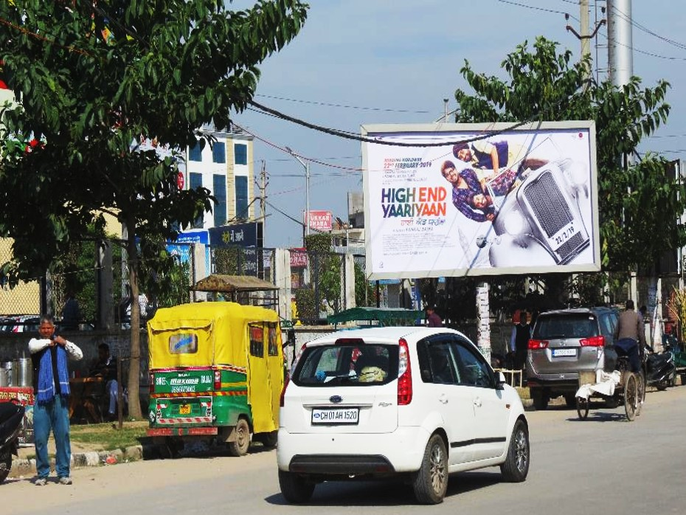
c
1. VIP Road Metro Mall , Zirakpur (Facing CCC)
Dimensions : 20x10 (W x H) @ ₹ 1,20,000/- PM

Slide 4
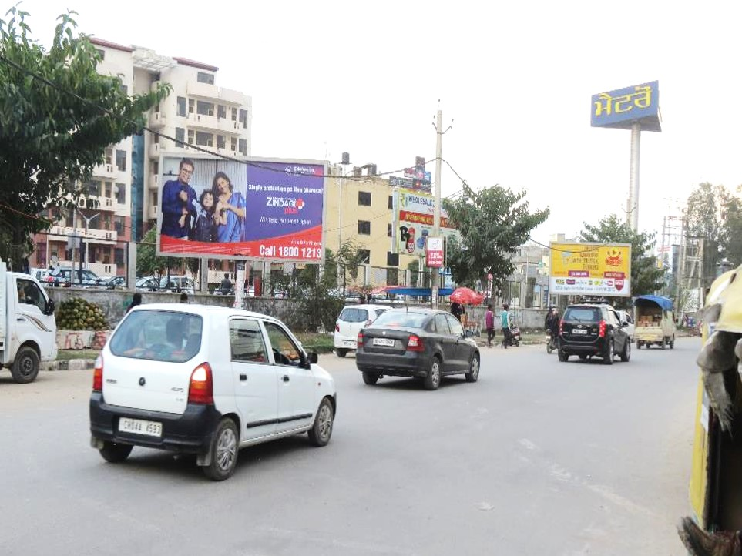
c
2. VIP Road Metro Mall , Zirakpur (Facing CCC)
Dimensions : 20x10 (W x H) @ ₹ 1,20,000/- PM

Slide 5
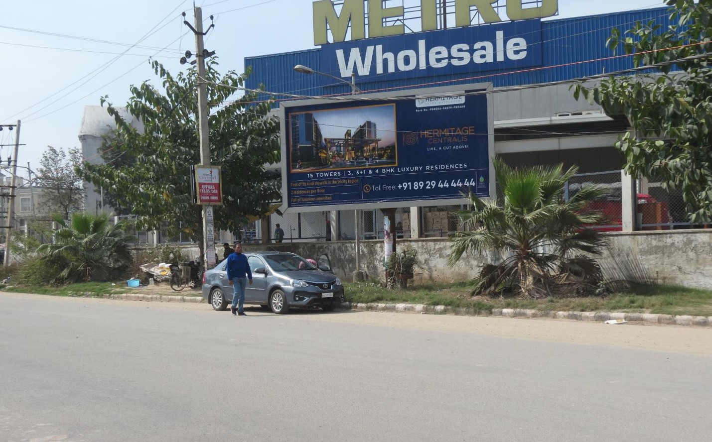
c
3. Entry VIP Road Metro Mall Zirakpur
Dimensions : 20x10 (W x H) @ ₹ 1,20,000/- PM

Slide 6
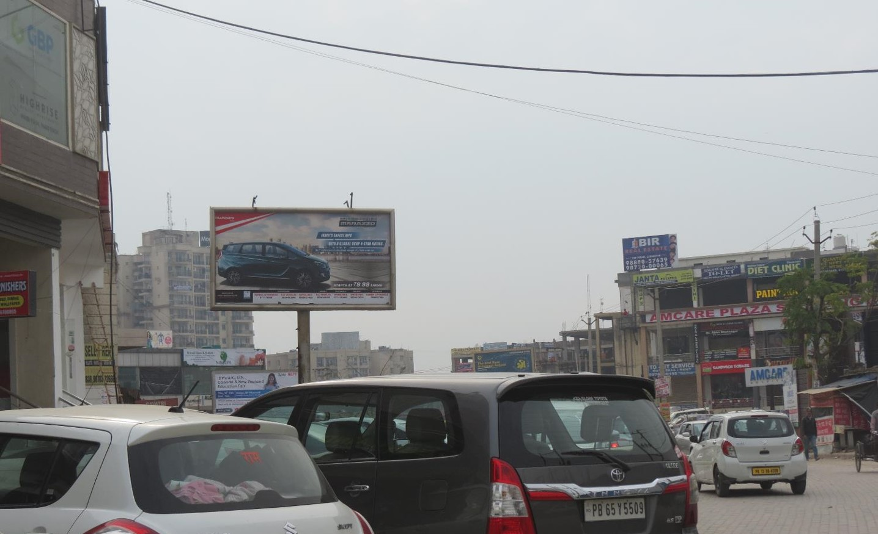
c
4. VIP Road Block-A Market, Zirakpur(Facing Metro Mall)
Dimensions : 20x10 (W x H) @ ₹ 1,20,000/- PM

Slide 7
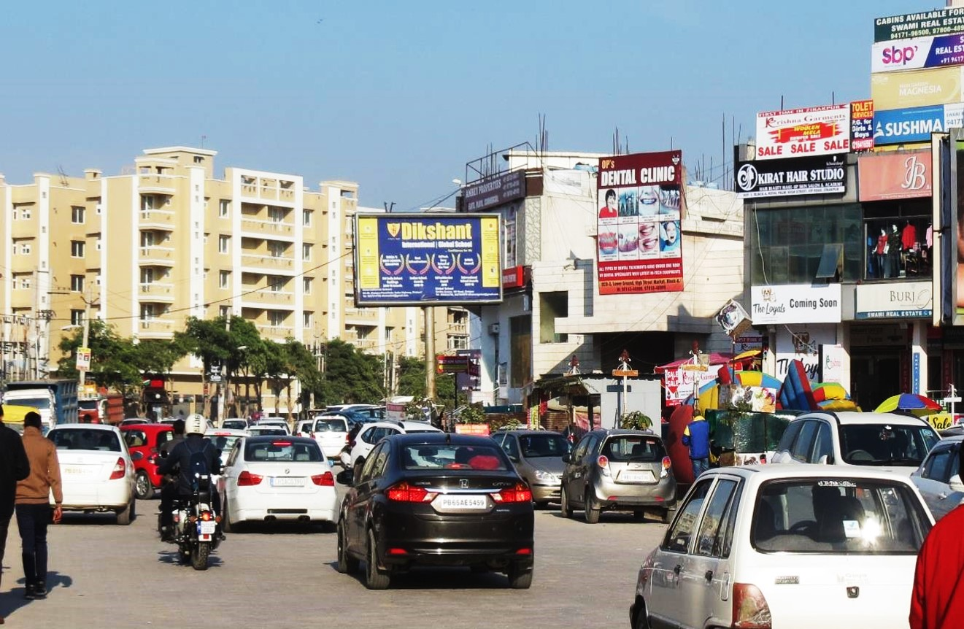
5. VIP Road Block-A Market, Zirakpur(Facing Chandigarh International Airport)
Dimensions : 20x10 (W x H) @ ₹ 1,20,000/- PM

Slide 8
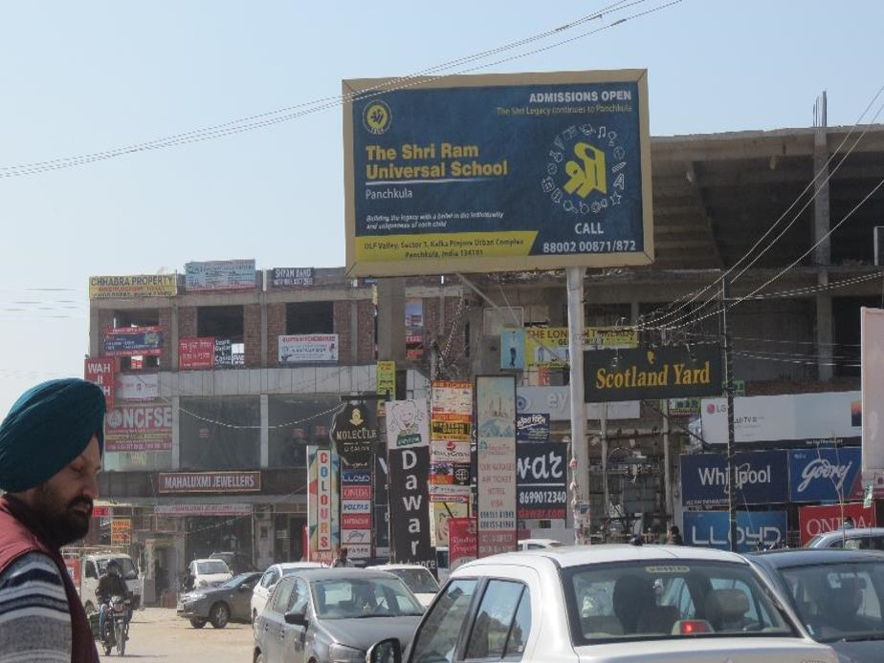
VIP ROAD SCOTLAND YARD 20x10 Facing METRO MALL @ 1,20,000/-PM
6. VIP ROAD SCOTLAND YARD , Zirakpur(Facing METRO MALL )
Dimensions : 20x10 (W x H) @ ₹ 1,44,000/- PM

Slide 9
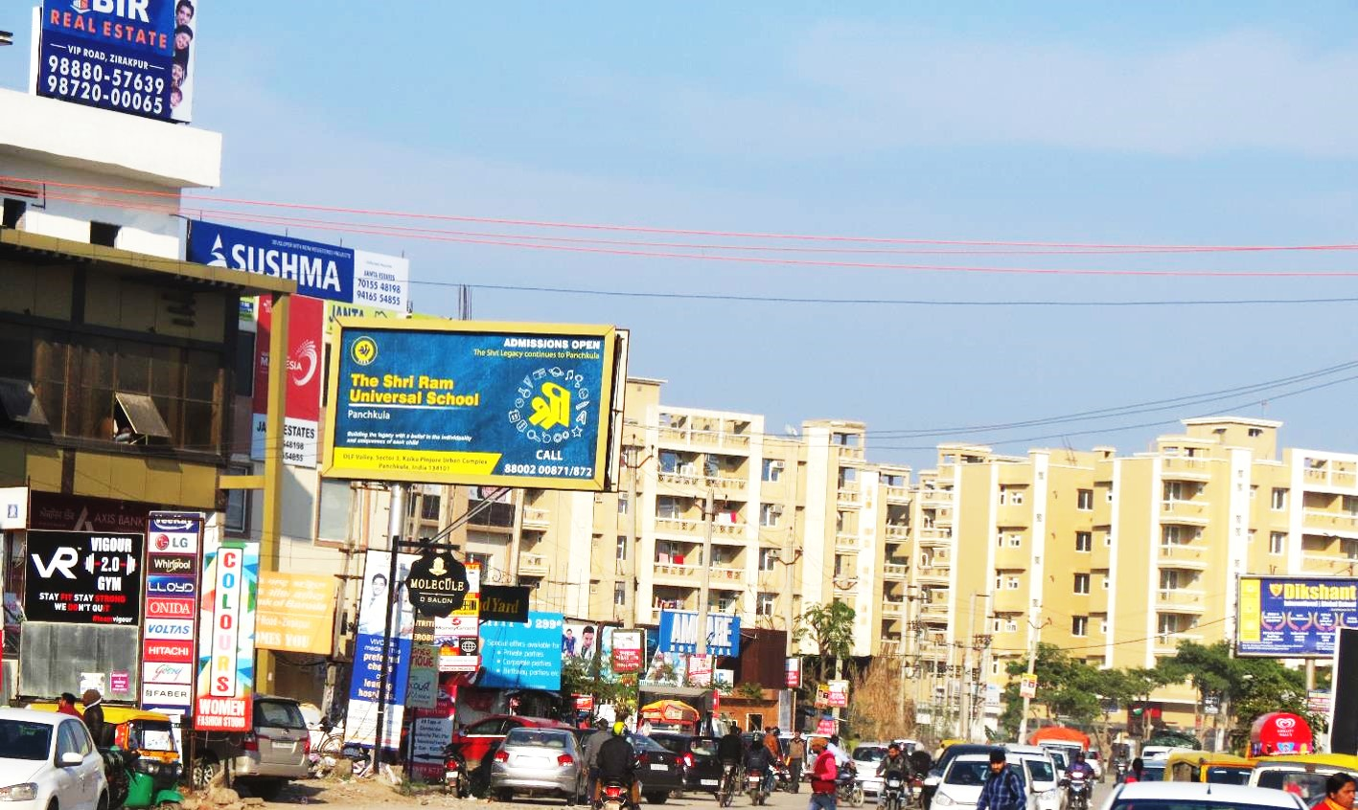
7. VIP ROAD SCOTLAND YARD , Zirakpur(Facing Chandigarh International Airport )
Dimensions : 20x10 (W x H) @ ₹ 1,44,000/- PM

Slide 10
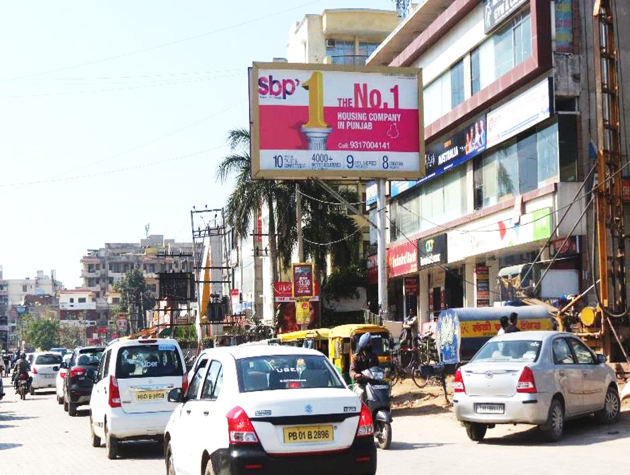
c
8. VIP Road J&K Bank, Zirakpur(Facing Metro Mall)
Dimensions : 20x10 (W x H) @ ₹ 1,44,000/- PM

Slide 11
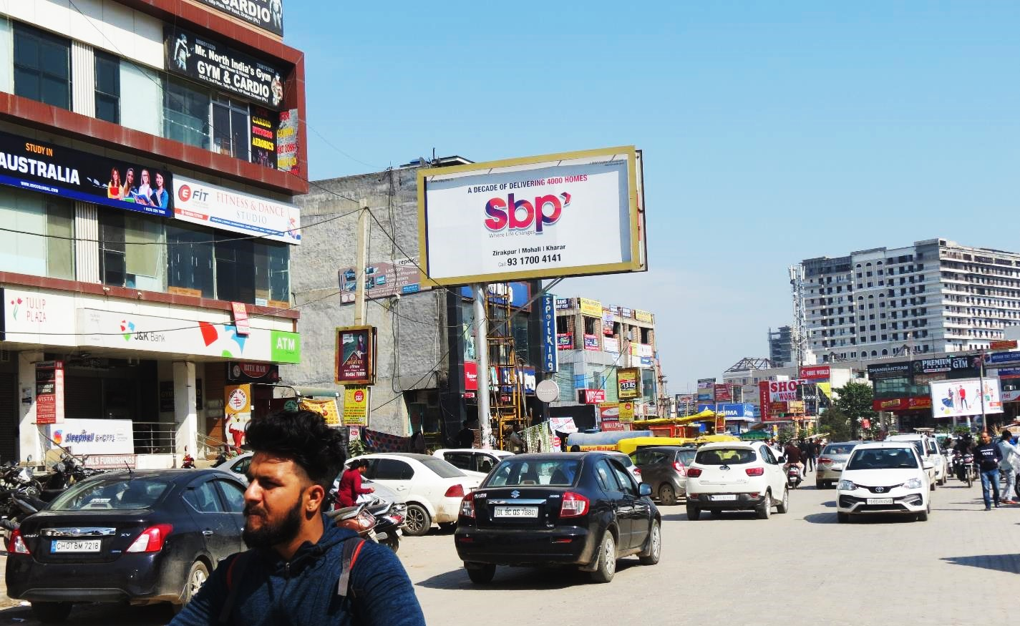
9. VIP Road J&K Bank, Zirakpur(Facing Chandigarh International Airport )
Dimensions : 20x10 (W x H) @ ₹ 1,44,000/- PM

Slide 12
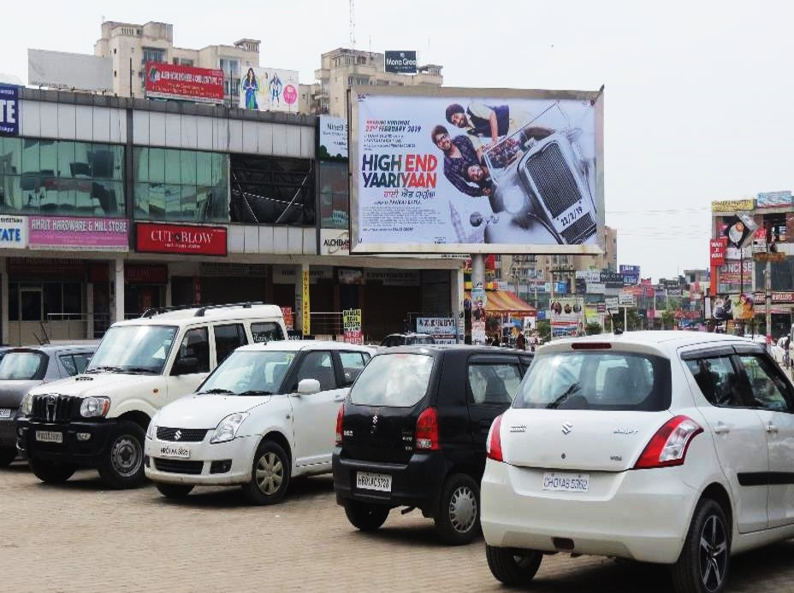
c
10. Block A Market VIP Road, Zirakpur (Facing Metro Mall )
Dimensions : 20x10 (W x H) @ ₹ 1,20,000/- PM

Slide 13
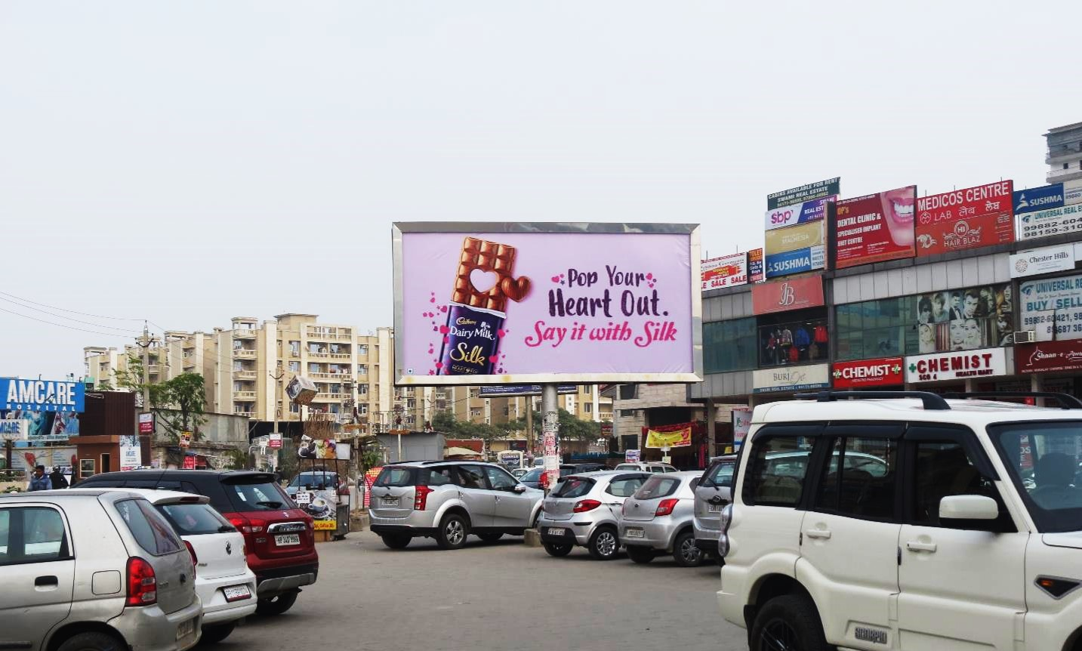
c
11. Block A Market VIP Road, Zirakpur (Facing DOMINOZ)
Dimensions : 20x10 (W x H) @ ₹ 1,20,000/- PM

Slide 14
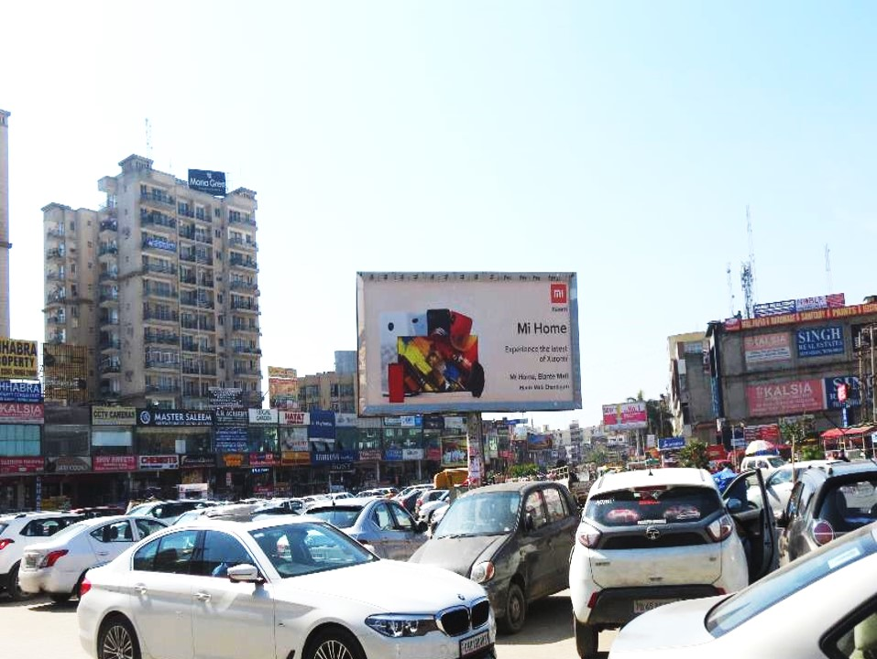
c
12. Block B Market VIP Road, Zirakpur (Facing Metro Mall)
Dimensions : 20x10 (W x H) @ ₹ 1,20,000/- PM

Slide 15
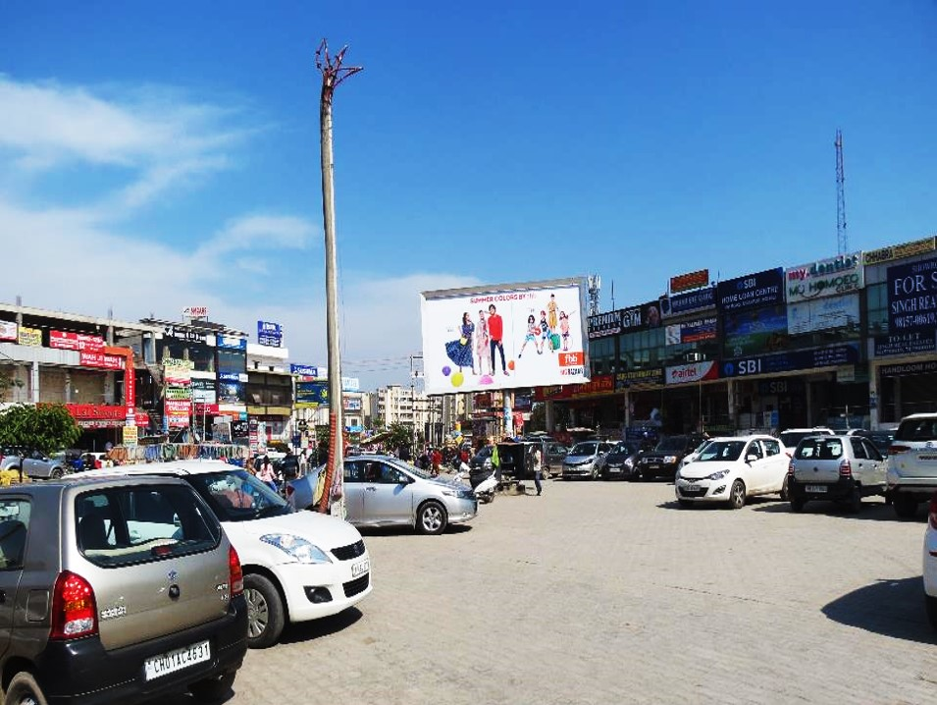
c
13. Block B Market VIP Road Zirakpur (Facing Chandigarh International Airport)
Dimensions : 20x10 (W x H) @ ₹ 1,20,000/- PM

Slide 16
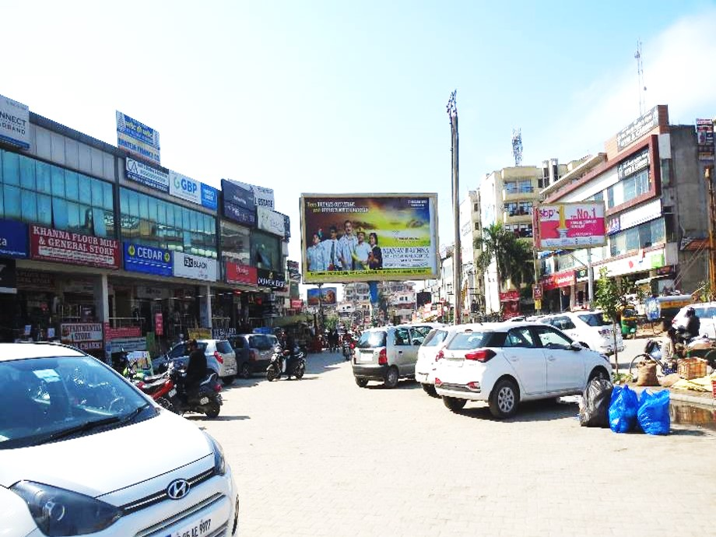
c
14. VIP Road B Block Gurpal Bakery Market Zirakpur (Facing Metro Mall )
Dimensions : 20x10 (W x H) @ ₹ 1,20,000/- PM

Slide 17
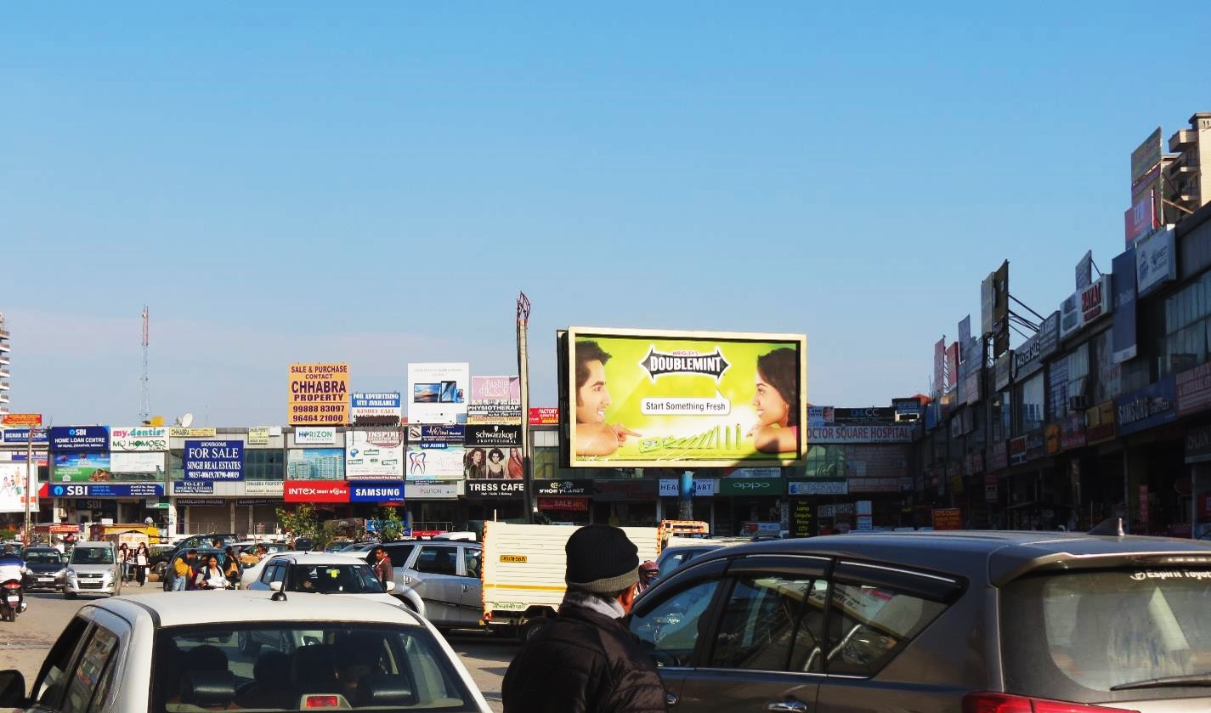
c
15. VIP Road B Block Gurpal Bakery Market Zirakpur (Facing Patiala side )
Dimensions : 20x10 (W x H) @ ₹ 1,20,000/- PM

Slide 18
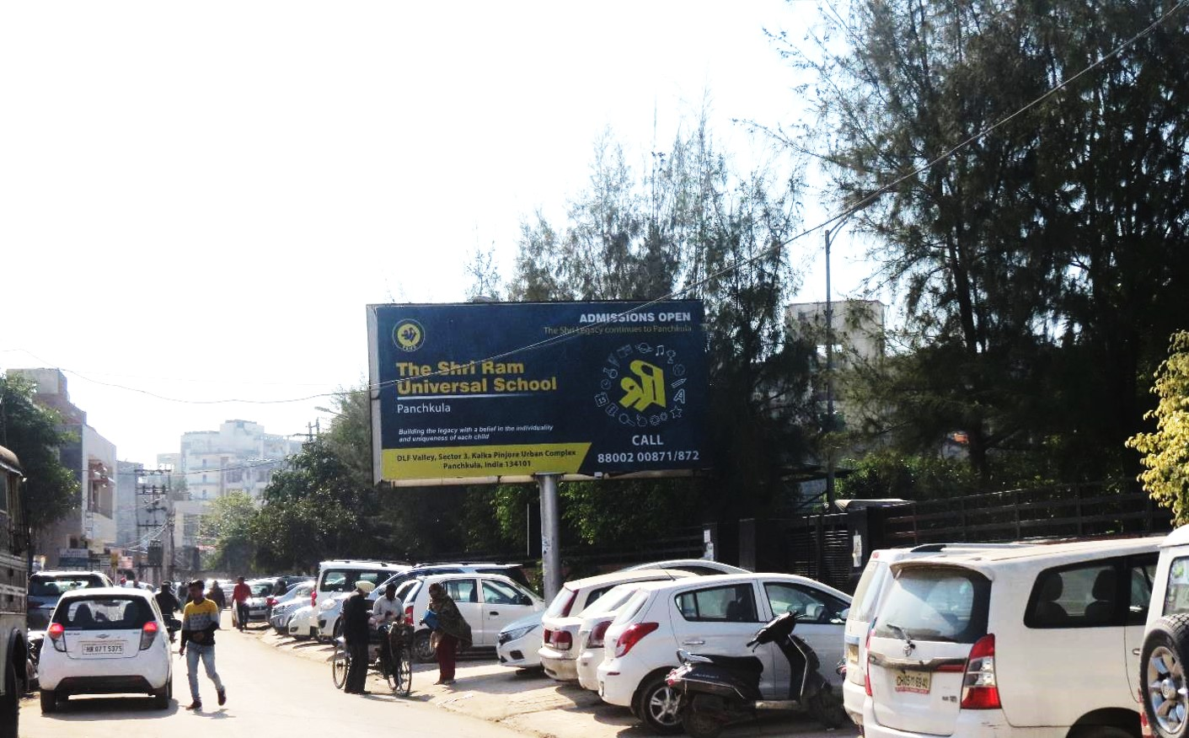
16. MC Office Zirakpur Opp Police Station Zirakpur (Facing MC GROUND)
Dimensions : 20x10 (W x H) @ ₹ 96,000/- PM

Slide 19
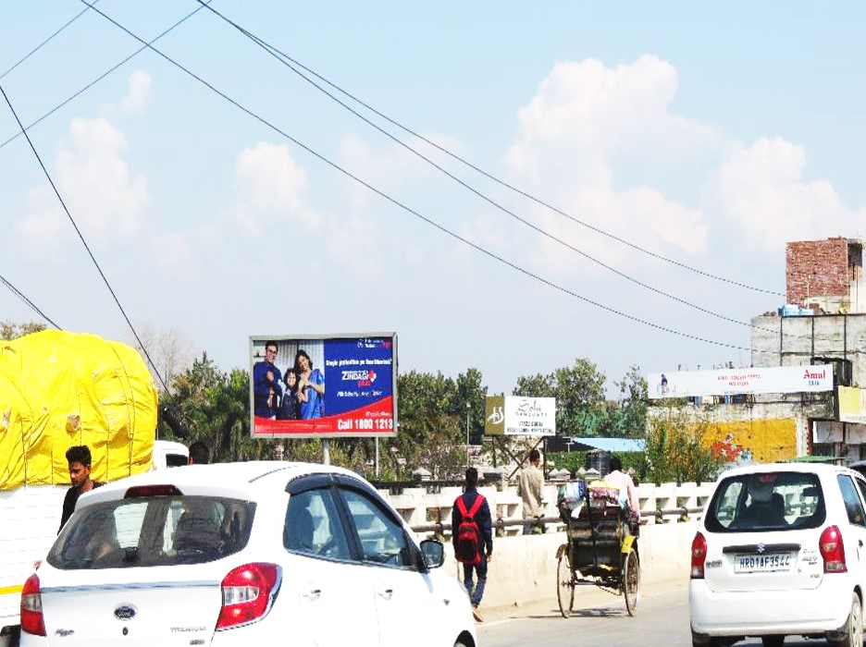
17. Sohi Banquet -Zirakpur Shimla Highway (Facing MC GROUND)
Dimensions : 20x10 (W x H) @ ₹ 96,000/- PM

Slide 20
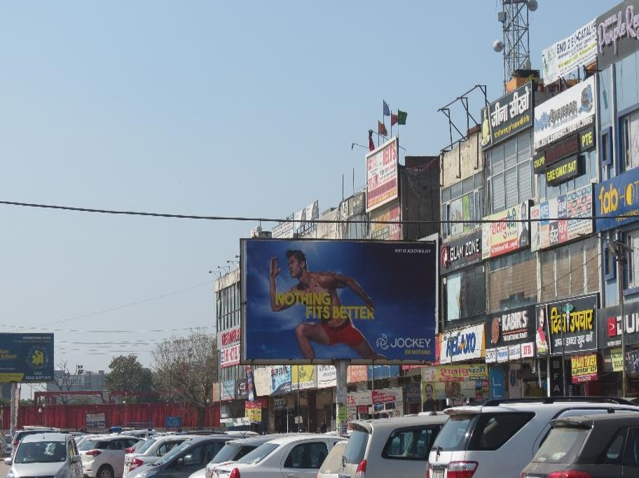
c
18. Kalghidhar Market Shimla Highway
Dimensions : 20x10 (W x H) @ ₹ 96,000/- PM

Slide 21
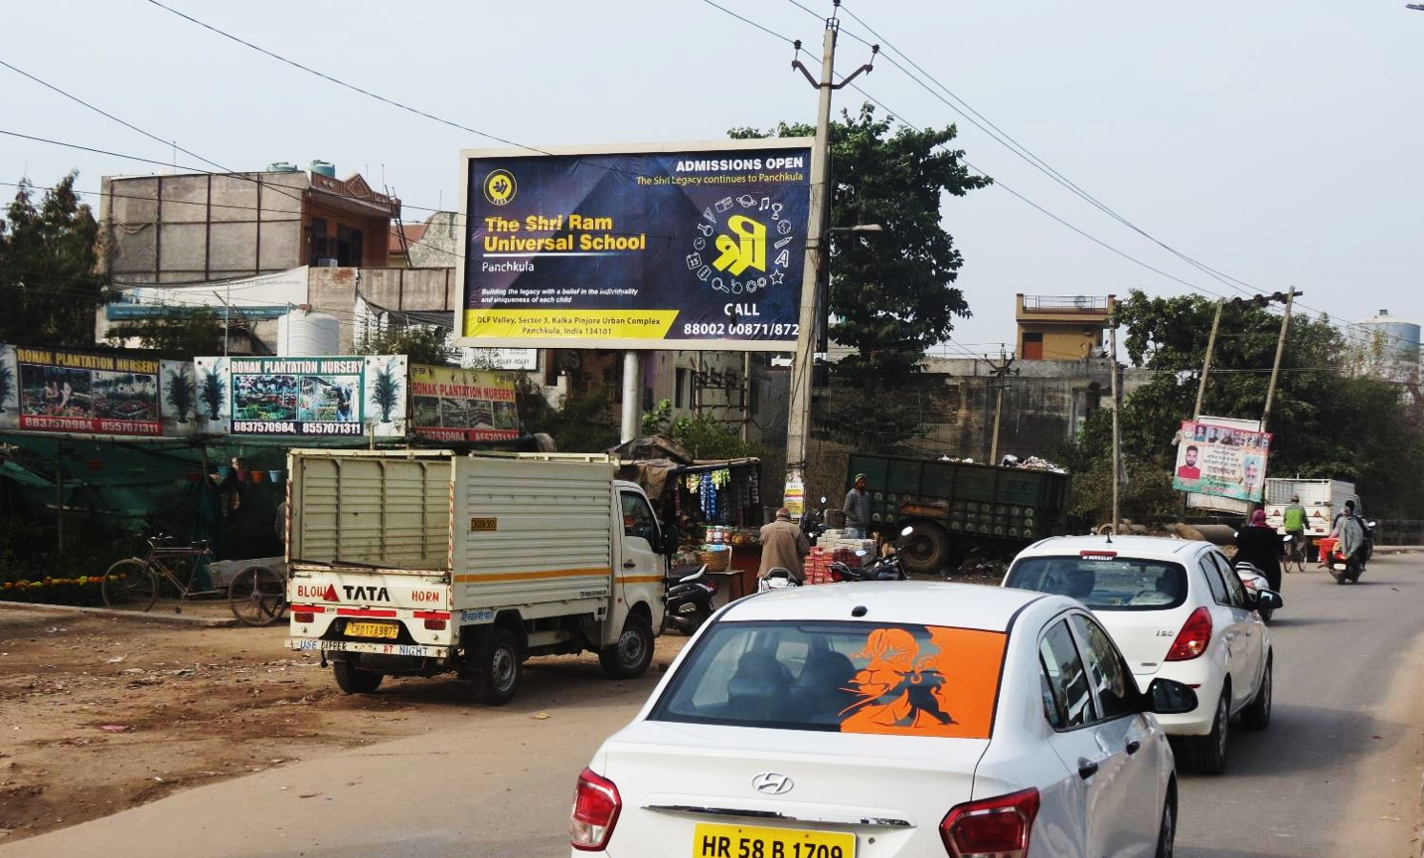
19. Dhakoli Opposite Harmitage
Dimensions : 20x10 (W X H) @ ₹ 96,000/- Pm

Slide 22
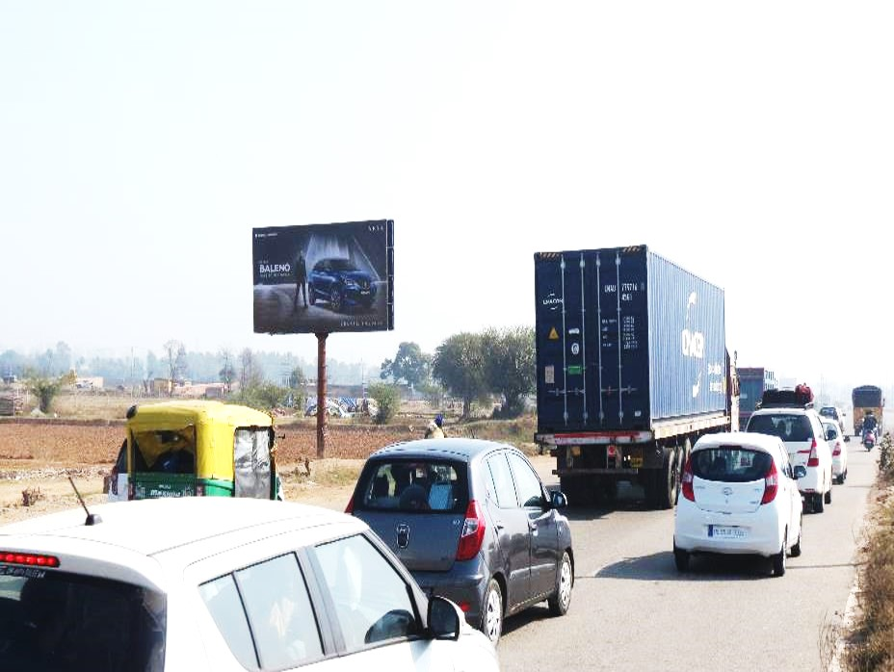
c
20. PR7 ZIRAKPUR -AIRPORT ROAD(Facing CHD INTERNATIONAL AIRPORT+)
Dimensions : 30x15 (W X H) @ ₹ 1,20,000/- Pm

Slide 23
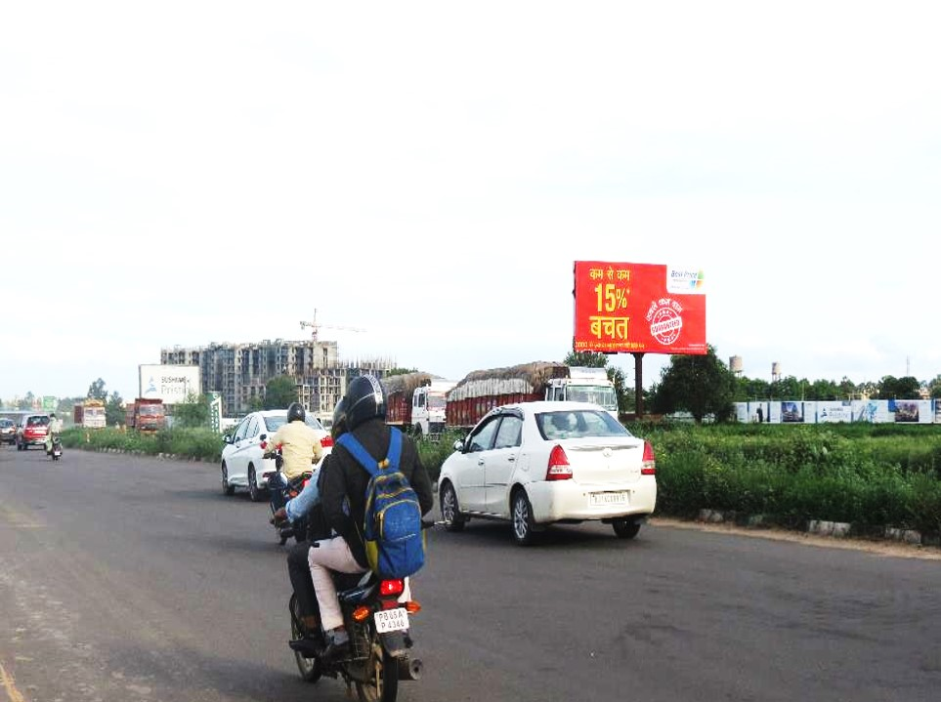
c
21. PR7 ZIRAKPUR -AIRPORT ROAD(Facing CHD INTERNATIONAL AIRPORT)
Dimensions : 30x15 (W X H) @ ₹ 1,20,000/- Pm

Slide 24
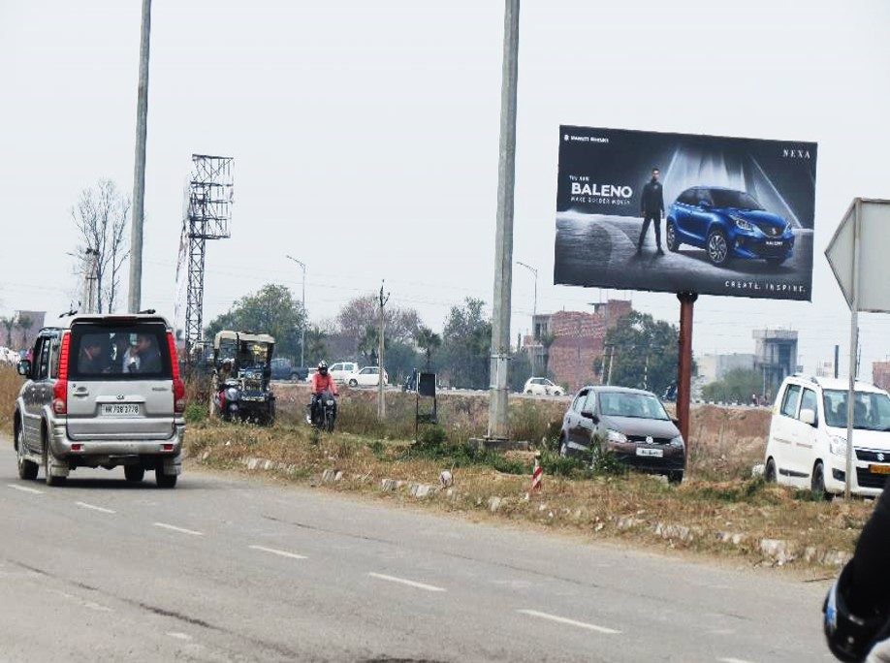
c
22. PR7 ZIRAKPUR -AIRPORT ROAD(Facing McDONALDS )
Dimensions : 30x15 (W X H) @ ₹ 1,20,000/- Pm

Slide 25
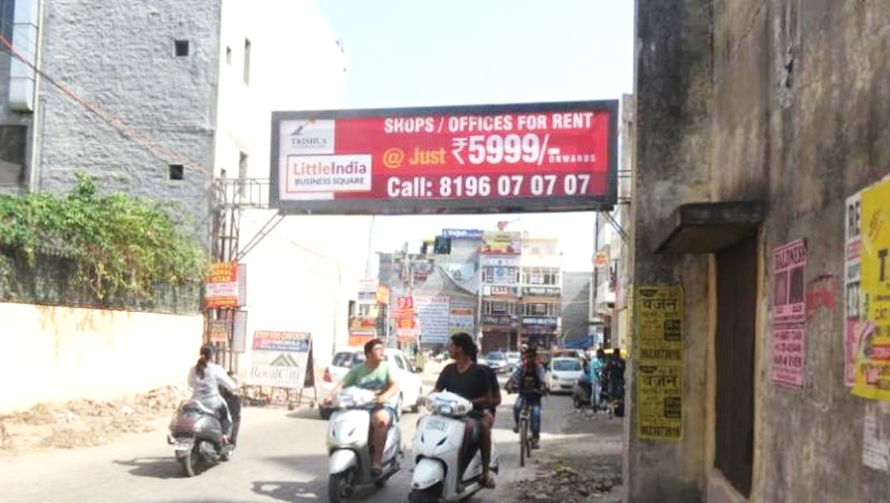
c
23. PEERMASHALA GANTRY Facing Sector 20 Panchkula )
Dimensions : 30x8 (W X H) @ ₹ 1,20,000/- Pm

Slide 26
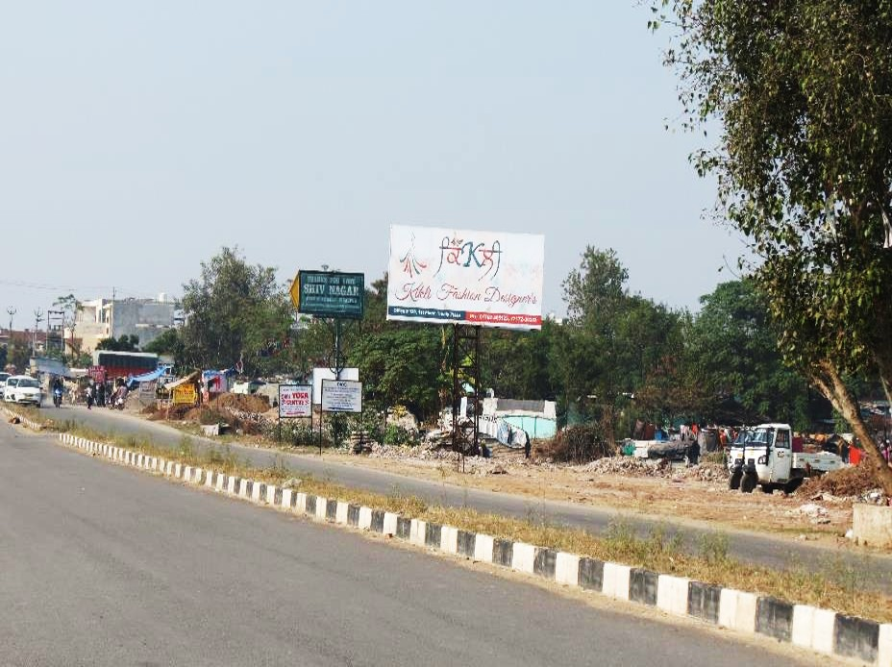
c
24. PEERMASHALA GANTRY (Facing DPS SCHOOL DHAKOALI )
Dimensions : 20x10 (W X H) @ ₹ 84,000/- Pm

Slide 27
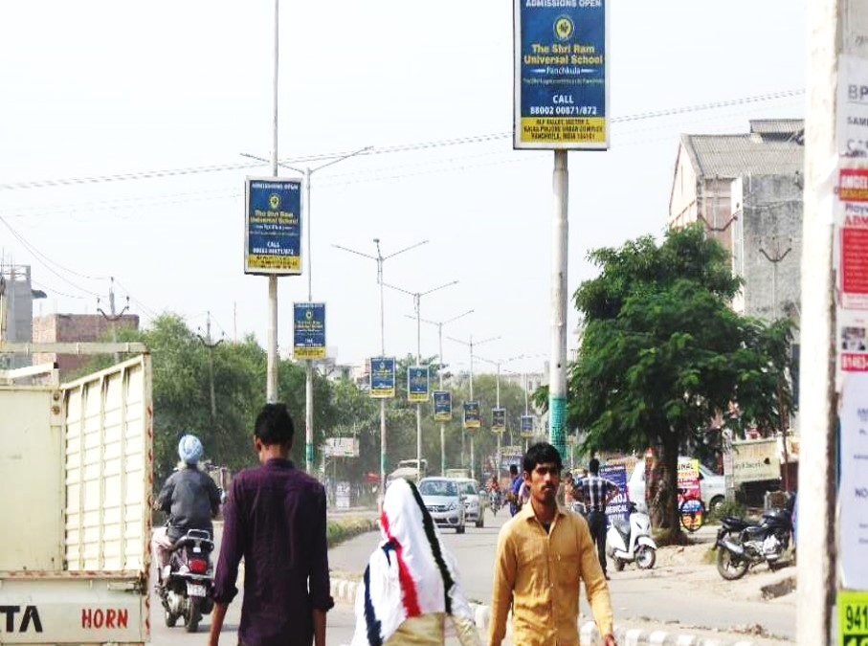
c
c
c
25. K AREA POLE KIOSKS – Total 25 Poles (Front and Back Combined)
Dimensions : 3 ft. x4 ft. (W X H) @ ₹ 4,200/- Per Pole Per Month.

Slide 28
DERABASSI

Slide 29
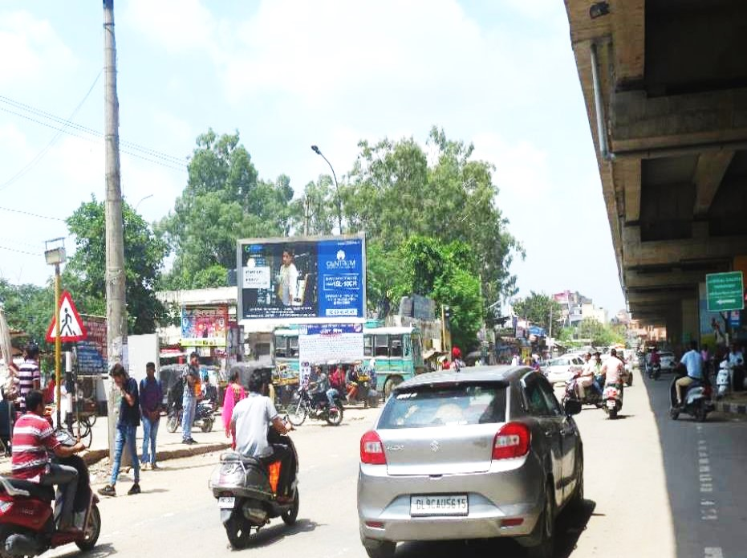
Derabassi Bus stand
Dimensions : 20 ft. x 10 ft. (W X H) @ ₹ 90,000/- Per Month.

Slide 30
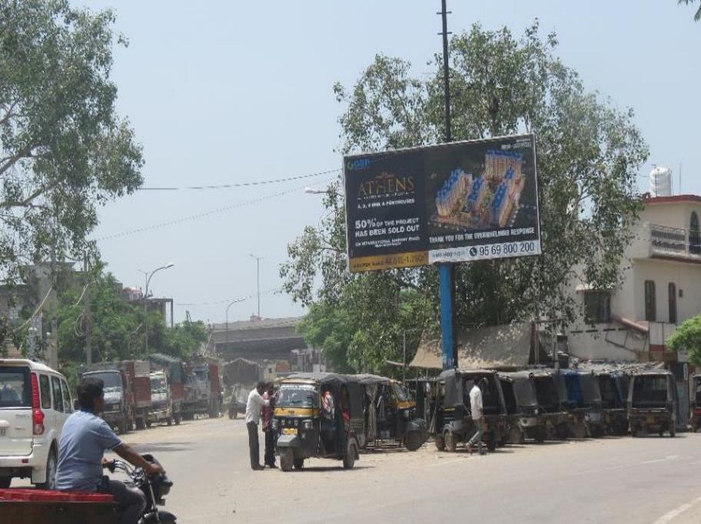
2. Derabassi T Point Barwala Road
Dimensions : 20 ft. x 10 ft. (W X H) @ ₹ 90,000/- Per Month.

Slide 31
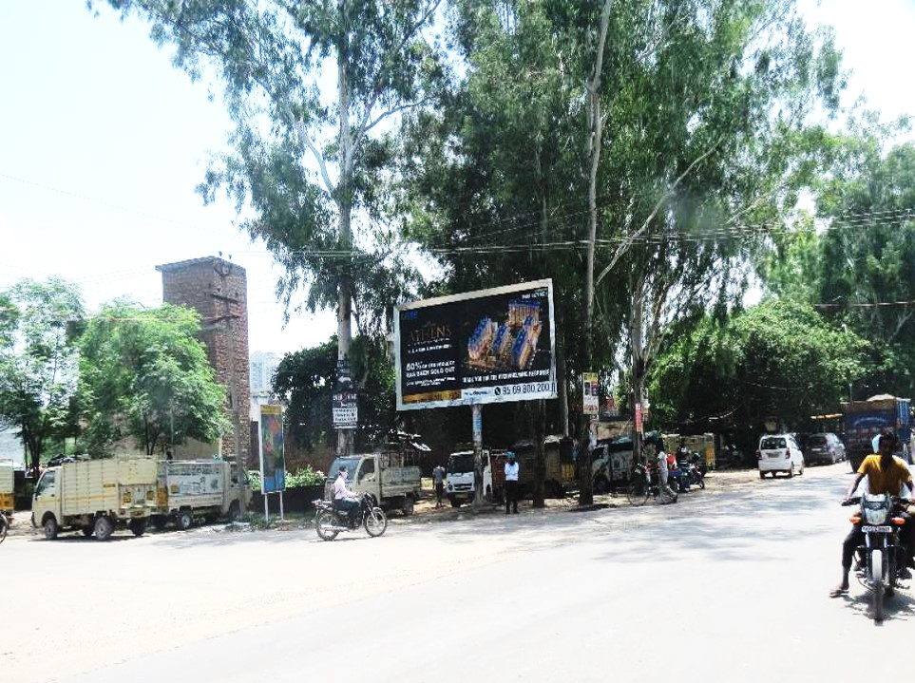
3. HAIBATPUR CHOWK, Old Ambala Road-Derabassi facing Peermashala Dhakoli
Dimensions : 20 ft. x 10 ft. (W X H) @ ₹ 90,000/- Per Month.

Slide 32
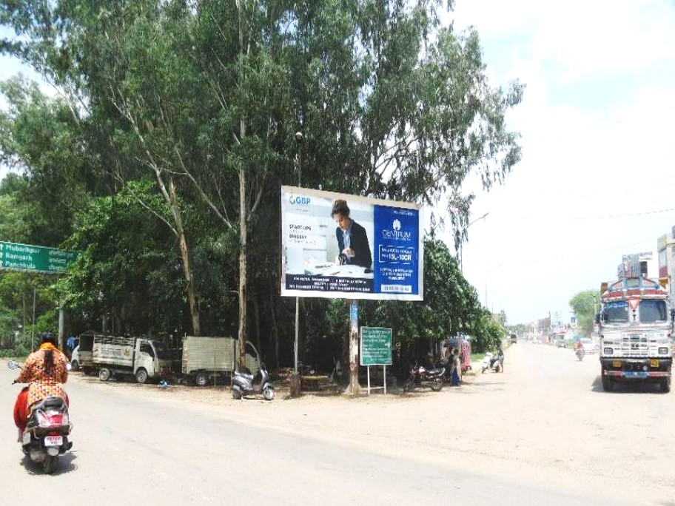
4. HAIBATPUR CHOWK, Old Ambala Road-Derabassi facing Ambala Highway
Dimensions : 20 ft. x 10 ft. (W X H) @ ₹ 90,000/- Per Month.

Slide 33
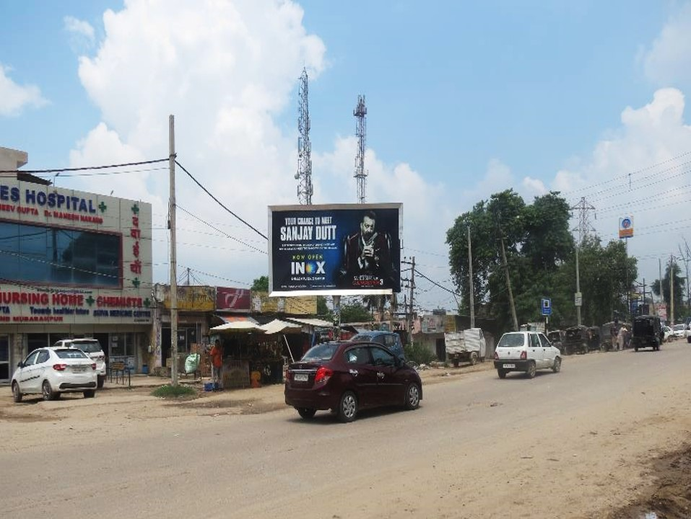
5. Derabassi Mubarikpur chowk Near Derabassi Police station (Old Ambala Road)
Dimensions : 20 ft. x 10 ft. (W X H) @ ₹ 90,000/- Per Month.

Slide 34
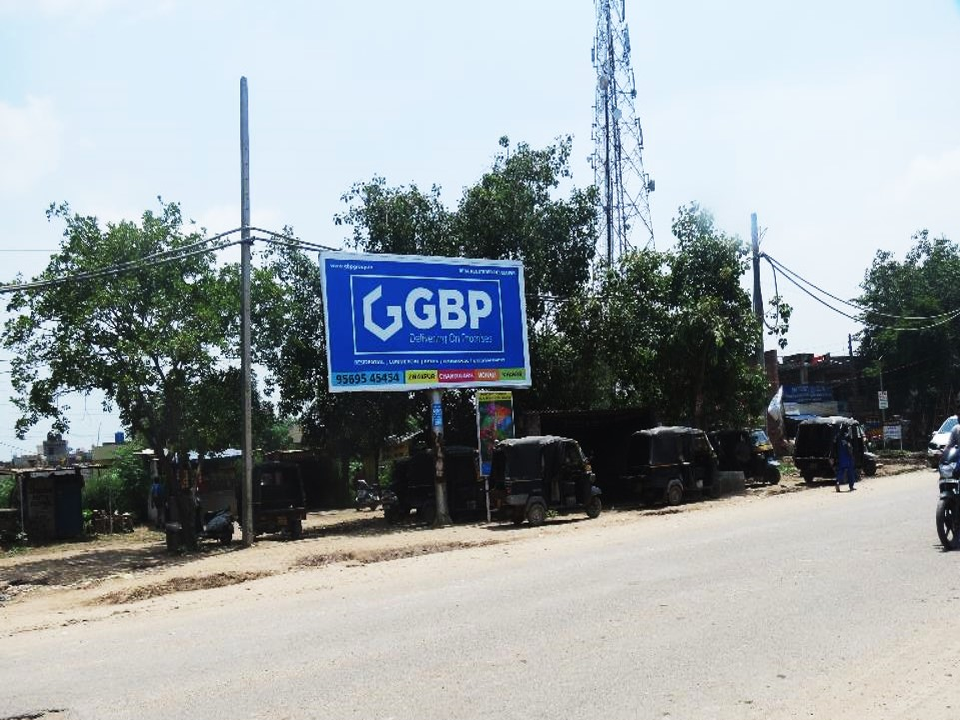
6. Derabassi Mubarikpur chowk Opp Gurudwara Sahib
Dimensions : 20 ft. x 10 ft. (W X H) @ ₹ 90000/- Per Month.

Slide 35
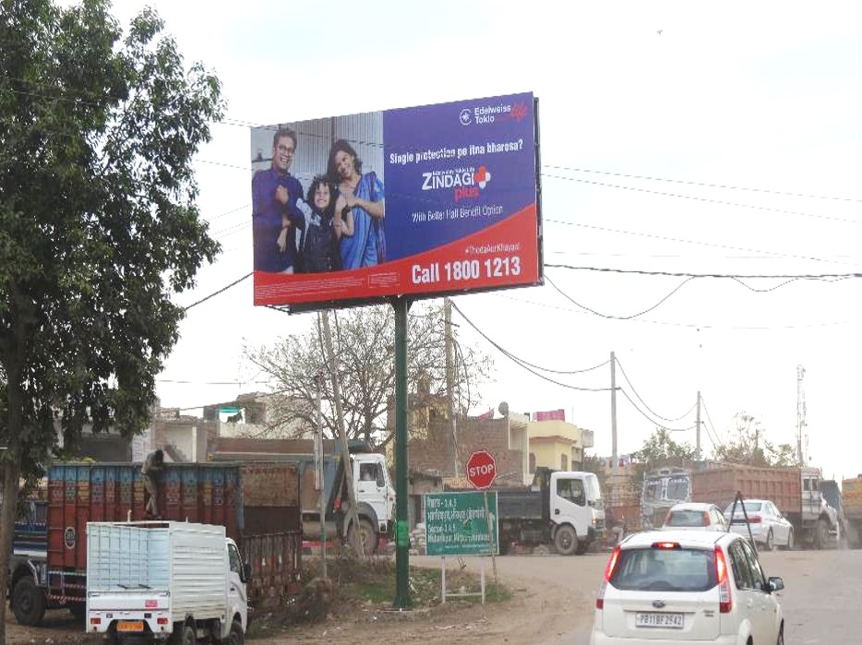
c
7. Derabassi Ramgarh Chowk 25ft x 12ft Facing Dhakoli Peermashala
Dimensions : 25 ft. x 12 ft. (W X H) @ ₹ 90,000/- Per Month.

Slide 36
LALRU

Slide 37
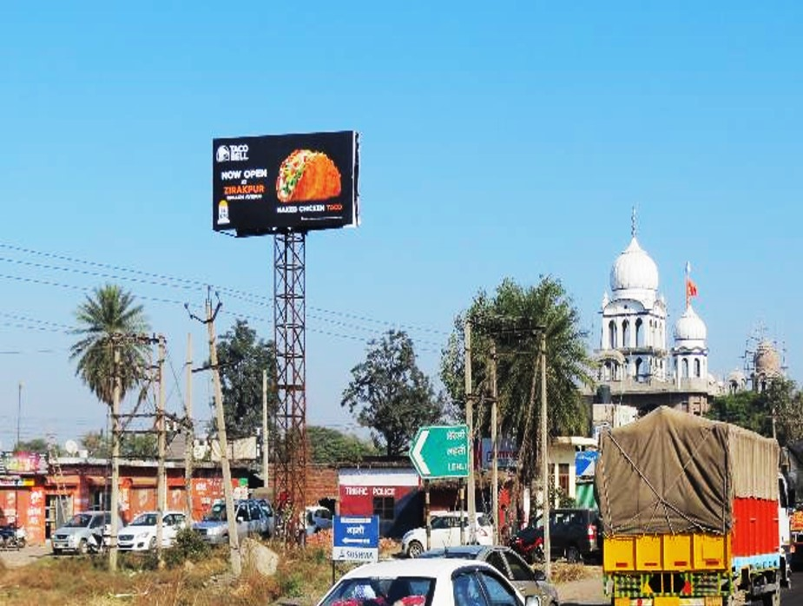
c
1. LALRU LEHLI LIGHTS – AMBALA CHANDIGARH HIGHWAY (Facing Delhi side )
Dimensions : 20 ft. x 10 ft. (W X H) @ ₹ 60,000/- Per Month.

Slide 38
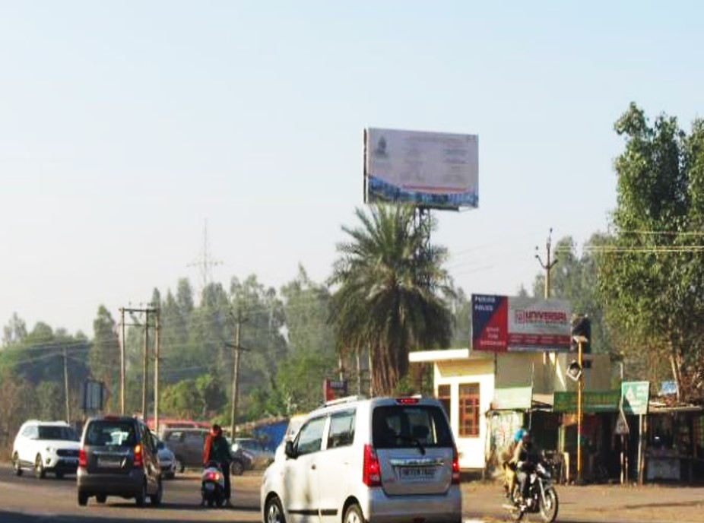
c
2. LALRU LEHLI LIGHTS –CHANDIGARH AMBALA HIGHWAY (Facing CHANDIGARH)
Dimensions : 20 ft. x 10 ft. (W X H) @ ₹ 60,000/- Per Month.

Slide 39
BANUR

Slide 40
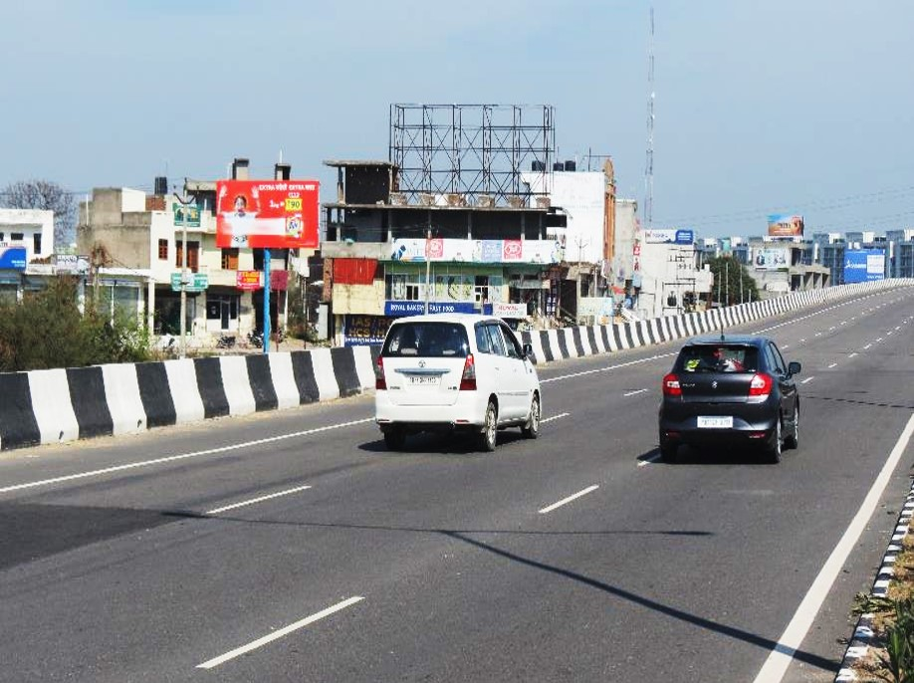
c
1. BANUR BUS STAND, PATIALA to Chandigarh HIGHWAY
Dimensions : 20 ft. x 10 ft. (W X H) @ ₹ 60,000/- Per Month.

Slide 41
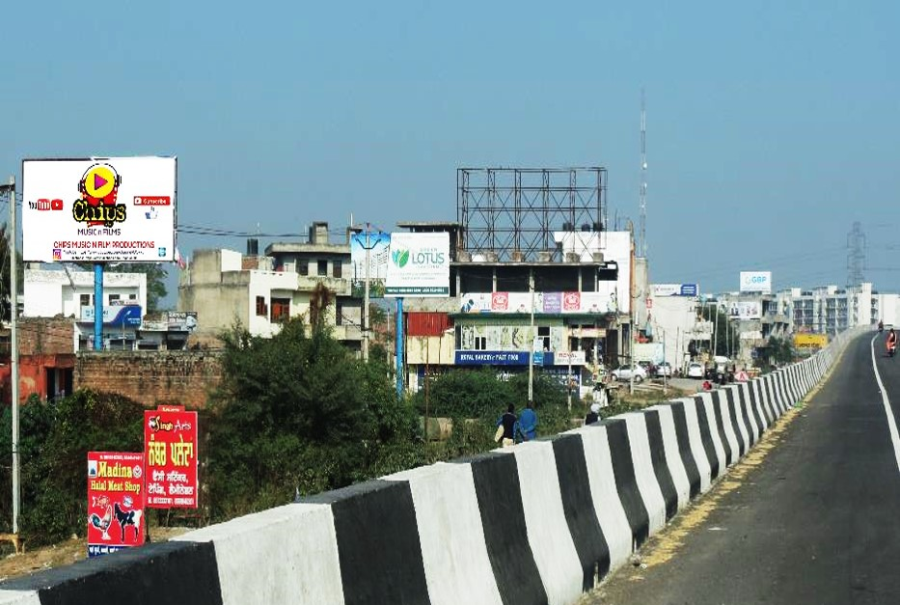
c
2. BANUR BUS STAND– PATIALA- CHANDIGARH HIGHWAY (Facing PATIALA side )
Dimensions : 20 ft. x 10 ft. (W X H) @ ₹ 60,000/- Per Month.

Slide 42
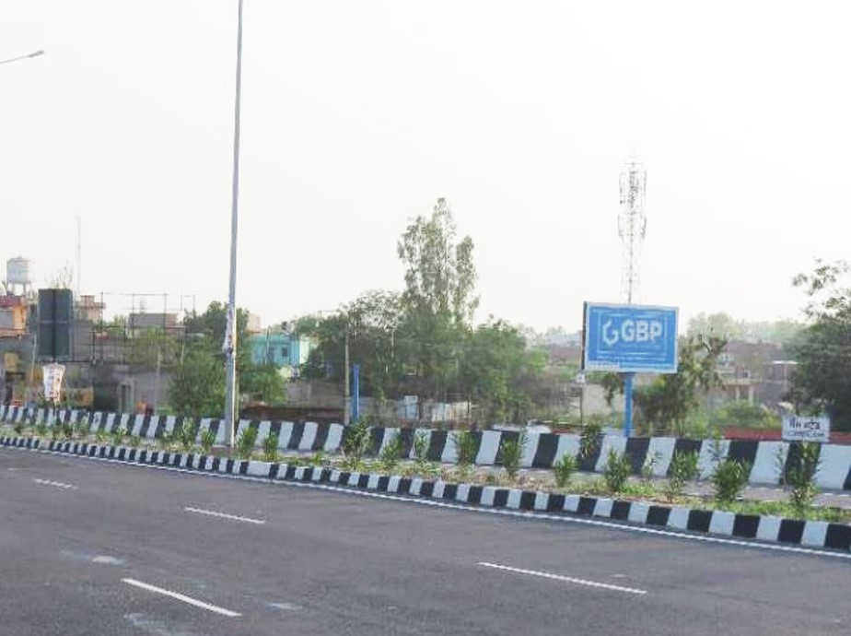
3. BANUR BUS STAND, CHANDIGARH TO PATIALA HIGHWAY
Dimensions : 20 ft. x 10 ft. (W X H) @ ₹ 60,000/- Per Month.

Slide 43
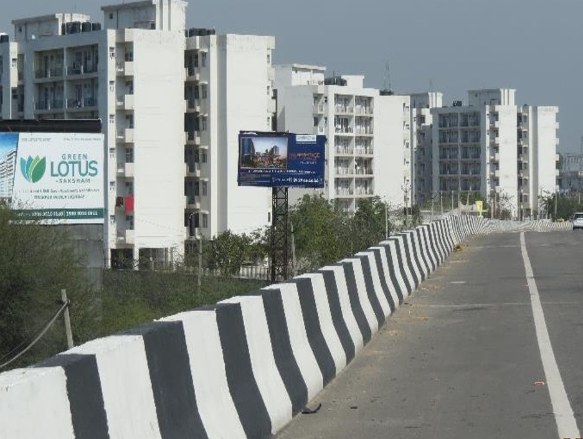
4. BANUR FLYOVER BANUR-ZIRAKPUR HIGHWAY
Dimensions : 20 ft. x 10 ft. (W X H) @ ₹ 60,000/- Per Month.

Slide 44
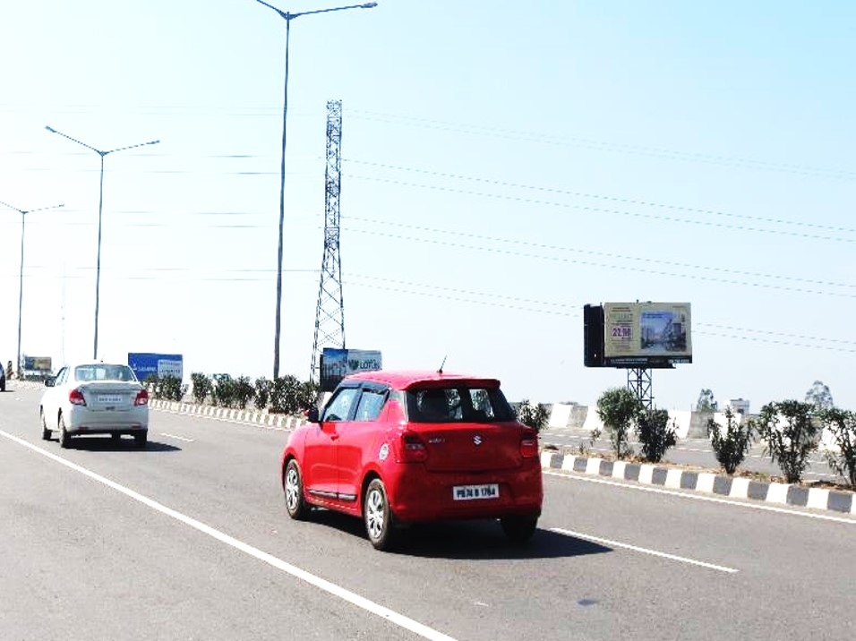
5. BANUR FLYOVER CHANDIGARH TO PATILA HIGHWAY
Dimensions : 20 ft. x 10 ft. (W X H) @ ₹ 60,000/- Per Month.

Slide 45
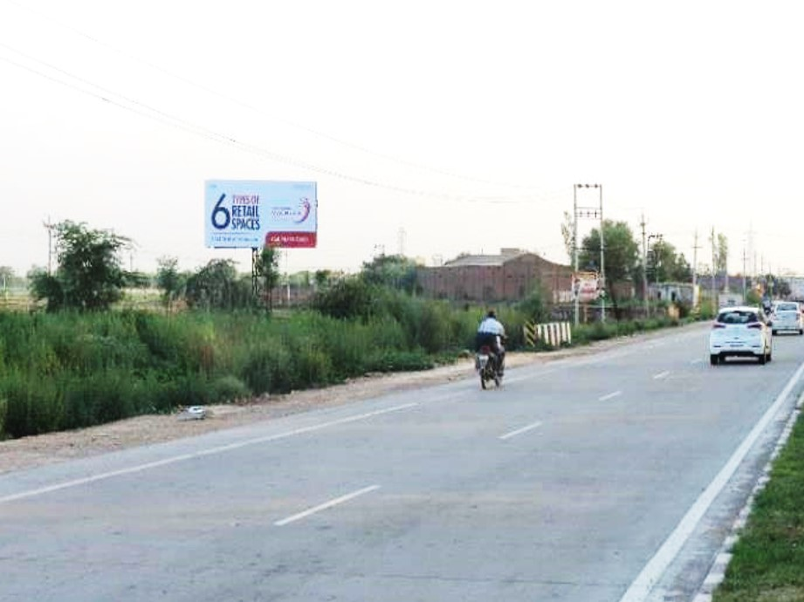
6. ENTRY BANUR CHANDIGARH TO PATILA HIGHWAY
Dimensions : 20 ft. x 10 ft. (W X H) @ ₹ 60,000/- Per Month.

Slide 46
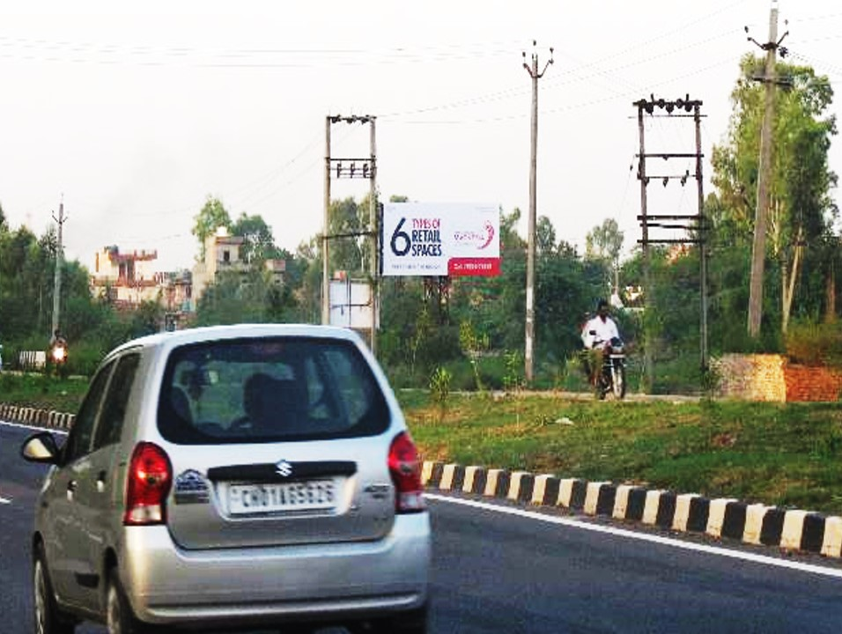
7. BANUR TO ZIRAKPUR HIGHWAY
Dimensions : 20 ft. x 10 ft. (W X H) @ ₹ 60,000/- Per Month.0

Slide 47
Thank You!
For Queries Contact Us:
Gaurav Saini - 8360409345
Monika Gaur - 9729934918
Reach Us @:
Sales.bigmediakart@gmail.com
Info.bigmediakart@gmail.com

