Slide 1
Outdoor Media Plan - Amritsar
Big Media Kart

Slide 2
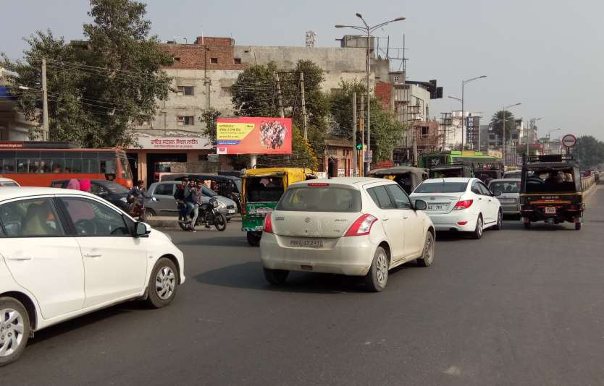
Location | Sadar Thana
City | Amritsar
Media | Unipole | Illumination | Non Lit
Size | 18’x8’ | Rate per Month | Rs.97500
Notes:
2

Slide 3
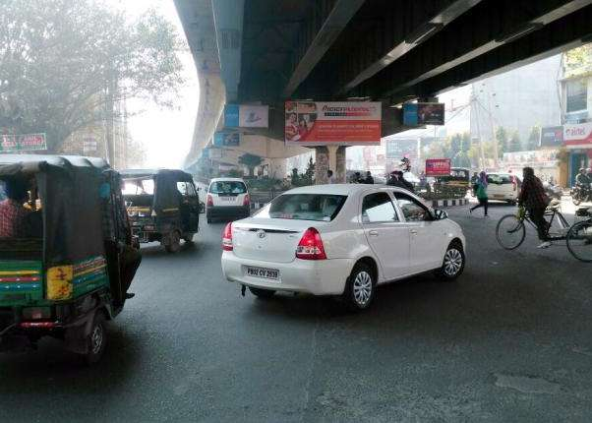
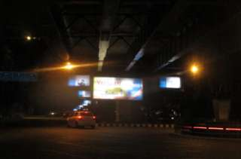
Location | Court Chowk
City | Amritsar
Media | Unipole | Illumination | Back Lit
Size | 18’x8’ | Rate per Month | Rs.110500
Notes:
3

Slide 4
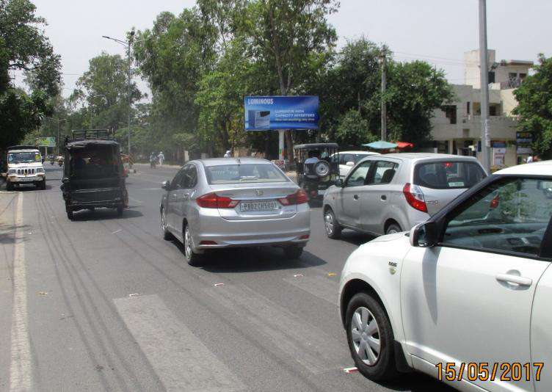
Location | Ranjit Avenue
City | Amritsar
Media | Unipole | Illumination | Non Lit
Size | 18’x8’ | Rate per Month | Rs.97500
Notes:
4

Slide 5
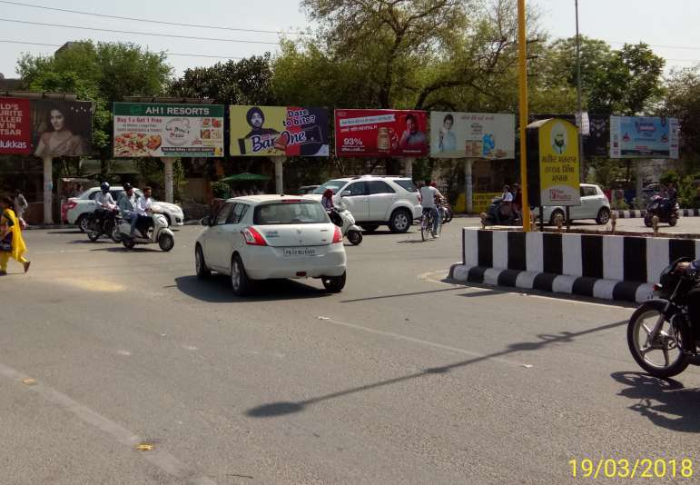
Location | MK Road T- Point
City | Amritsar
Media | Unipole | Illumination | Non Lit
Size | 18’x8’ | Rate per Month | Rs.97500
Notes:
5

Slide 6
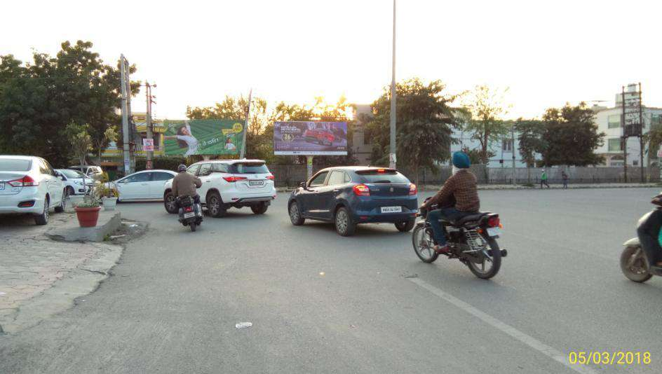
Location | Opp. Best Western
City | Amritsar
Media | Unipole | Illumination | Non Lit
Size | 18’x8’ | Rate per Month | Rs.97500
Notes:
6

Slide 7
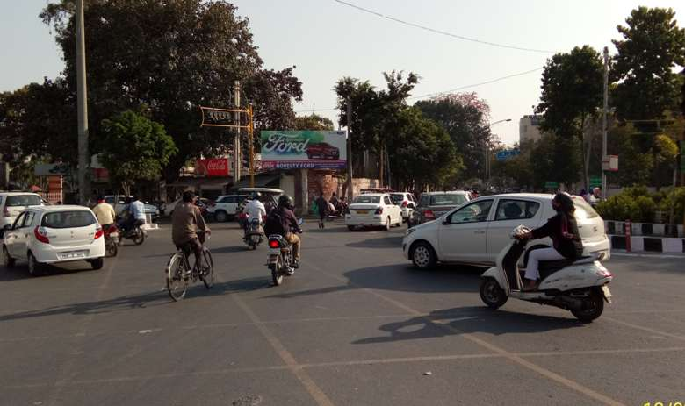
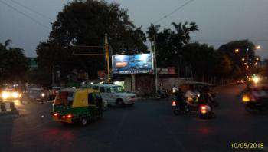
Location | Rialto Chowk
City | Amritsar
Media | Unipole | Illumination | Front Lit
Size | 18’x8’ | Rate per Month | Rs.105000
Notes:
7

Slide 8
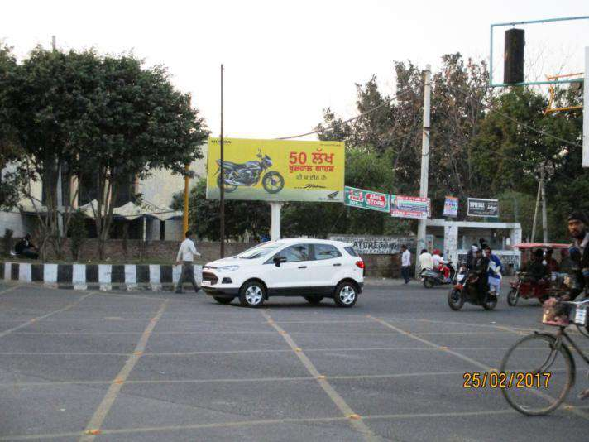
Location | Railway Station
City | Amritsar
Media | Unipole | Illumination | Non Lit
Size | 18’x8’ | Rate per Month | Rs.97500
Notes:
8

Slide 9
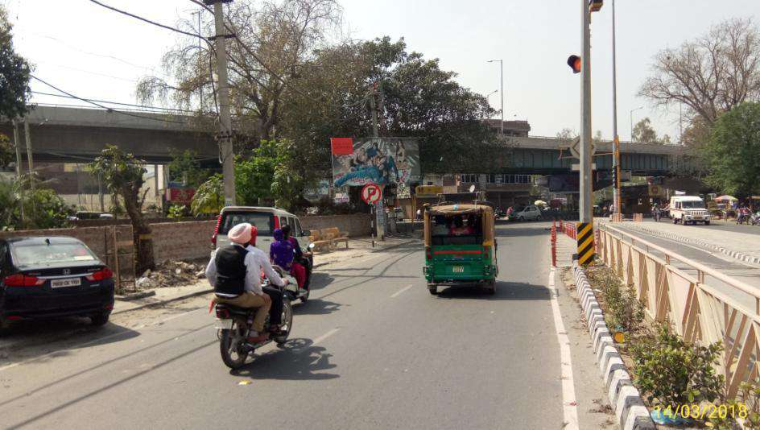
Location | Mall Road
City | Amritsar
Media | Unipole | Illumination | Non Lit
Size | 18’x8’ | Rate per Month | Rs.97500
Notes:
9

Slide 10
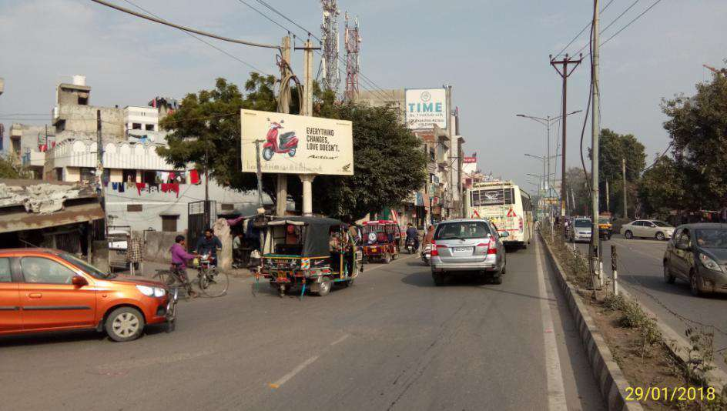
Location | Ratan Singh Chowk
City | Amritsar
Media | Unipole | Illumination | Non Lit
Size | 18’x8’ | Rate per Month | Rs.97500
Notes:
10

Slide 11
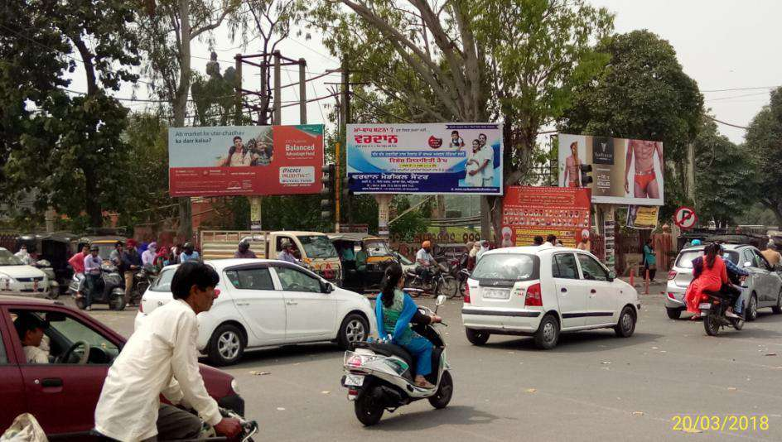
Location | SSSS Chowk
City | Amritsar
Media | Unipole | Illumination | Non Lit
Size | 18’x8’ | Rate per Month | Rs.97500
Notes:
11

Slide 12
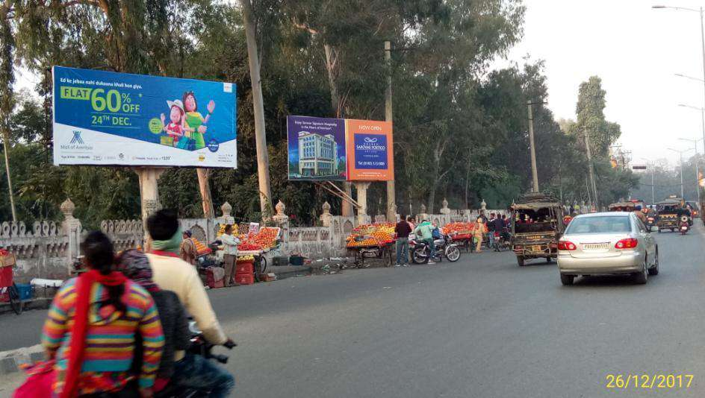
Location | Hukam Singh Road
City | Amritsar
Media | Unipole | Illumination | Non Lit
Size | 18’x8’ | Rate per Month | Rs.97500
Notes:
12

Slide 13
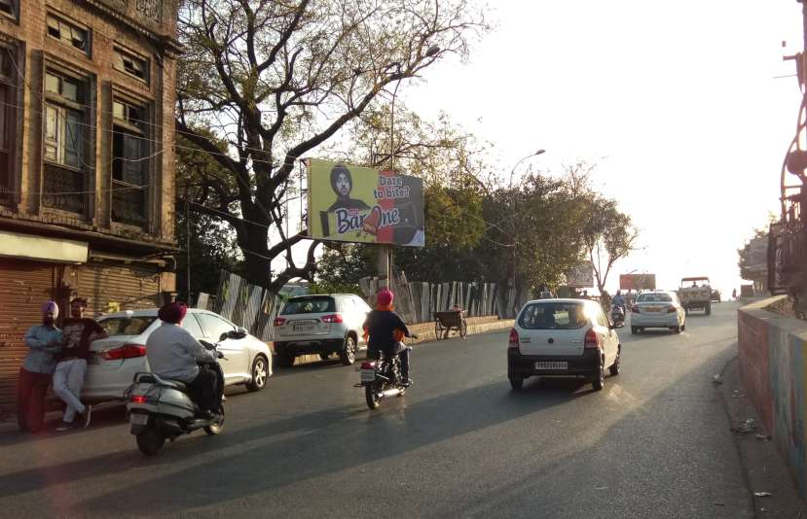
Location | Bhandari Bridge
City | Amritsar
Media | Unipole | Illumination | Non Lit
Size | 18’x8’ | Rate per Month | Rs.97500
Notes:
13

Slide 14
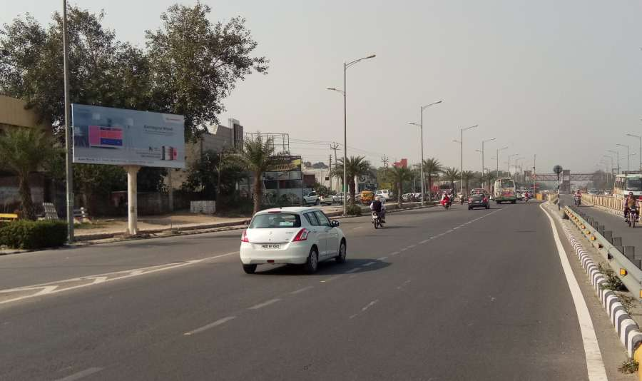
Location | New Amritsar, Nr. Alpha One Mall
City | Amritsar
Media | Unipole | Illumination | Non Lit
Size | 18’x8’ | Rate per Month | Rs.97500
Notes:
14

Slide 15
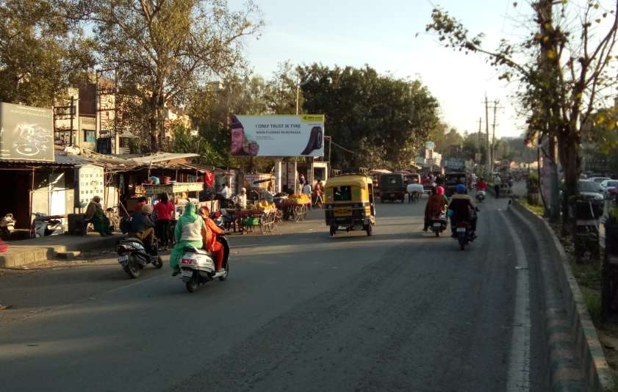
Location | Shaheedan Road
City | Amritsar
Media | Unipole | Illumination | Non Lit
Size | 18’x8’ | Rate per Month | Rs.97500
Notes:
15

Slide 16
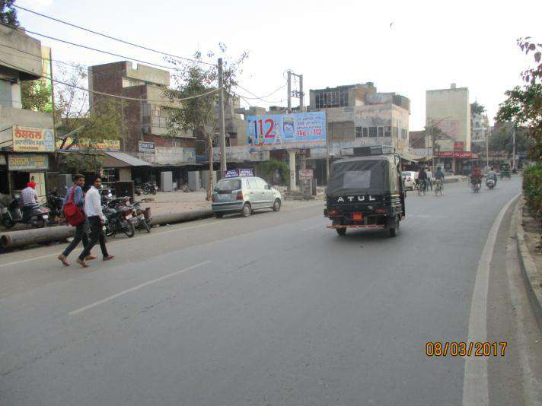
Location | Ajit Nagar
City | Amritsar
Media | Unipole | Illumination | Non Lit
Size | 18’x8’ | Rate per Month | Rs.97500
Notes:
16

Slide 17
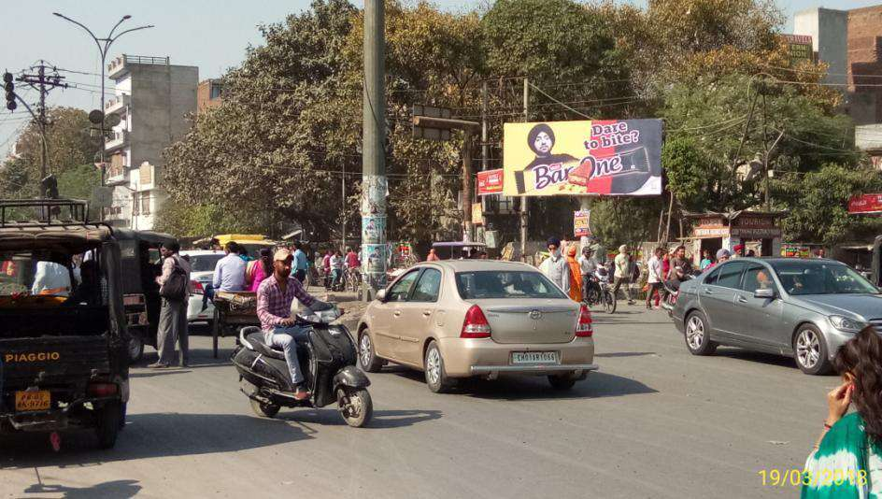
Location | Mahan Singh Gate
City | Amritsar
Media | Unipole | Illumination | Non Lit
Size | 18’x8’ | Rate per Month | Rs.97500
Notes:
17

Slide 18
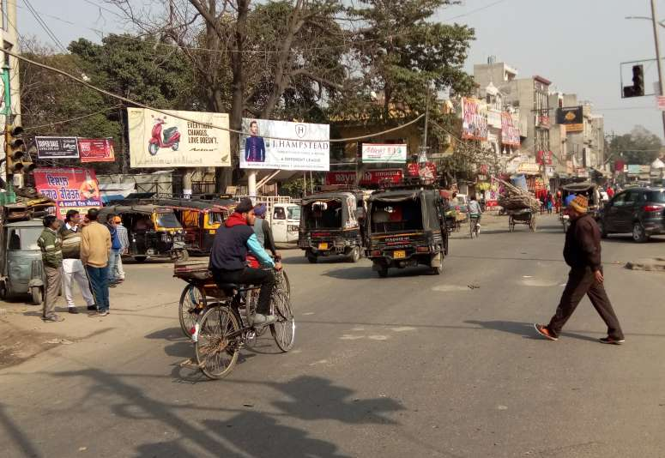
Location | Pink Plaza
City | Amritsar
Media | Unipole | Illumination | Non Lit
Size | 18’x8’ | Rate per Month | Rs.97500
Notes:
18

Slide 19
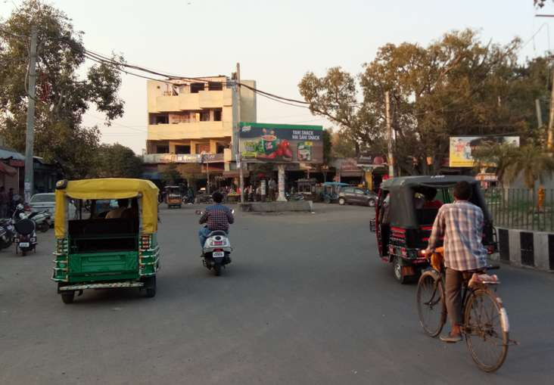
Location | Hathi Gate
City | Amritsar
Media | Unipole | Illumination | Non Lit
Size | 18’x8’ | Rate per Month | Rs.97500
Notes:
19

Slide 20
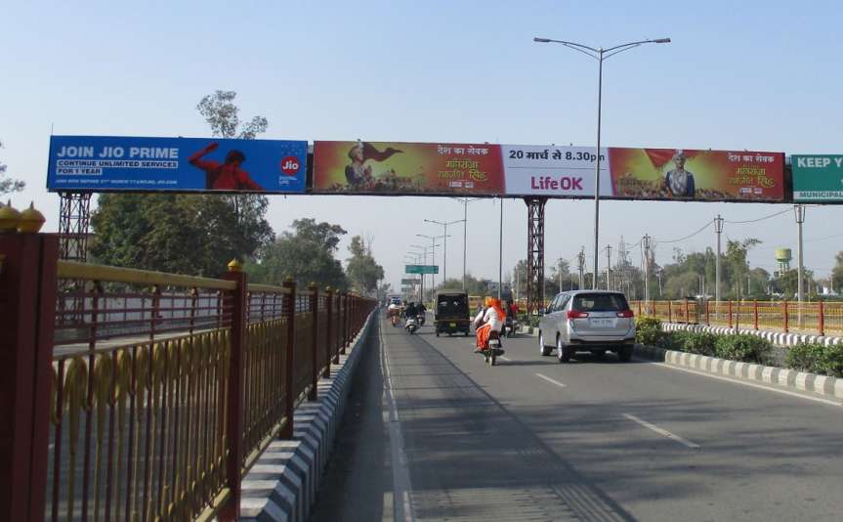
Location | Airport Road
City | Amritsar
Media | Gantry | Illumination | Non Lit
Size | 77’x8’ | Rate per Month | Rs.325000

Slide 21
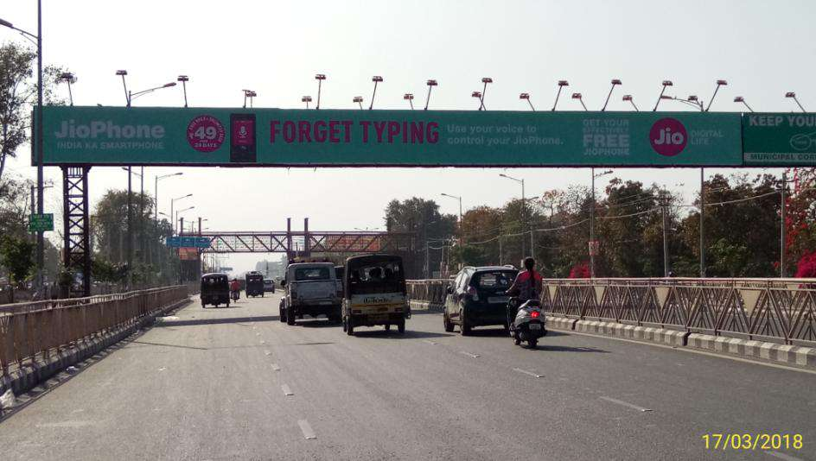
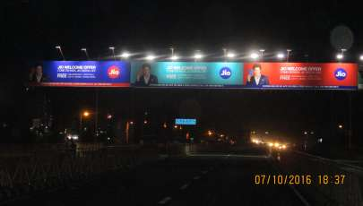
Location | GNDU University
City | Amritsar
Media | Gantry | Illumination | Non Lit
Size | 104’x8’ | Rate per Month | Rs.357000

Slide 22
Terms & Conditions:
1. GST will be extra @ 18%.
2. Any damage to the flex due to heavy wind / storm activity or any rain Thunder-
shower activity, the cost of reprinting of the flex will be borne by client.
3. The sites are subject to the availability.
4. Printing Charges will be extra.
Mounting charges will be extra.
6. 100% Payment advance in the favour of “ Redzo Media Solutions Pvt. Ltd “.

Slide 23
Thank You!
For Queries
Contact Us: 8360409345
Reach Us @:
marketing@bigmediakart.com

