Slide 1
Outdoor Media Plan - Hisar

Slide 2
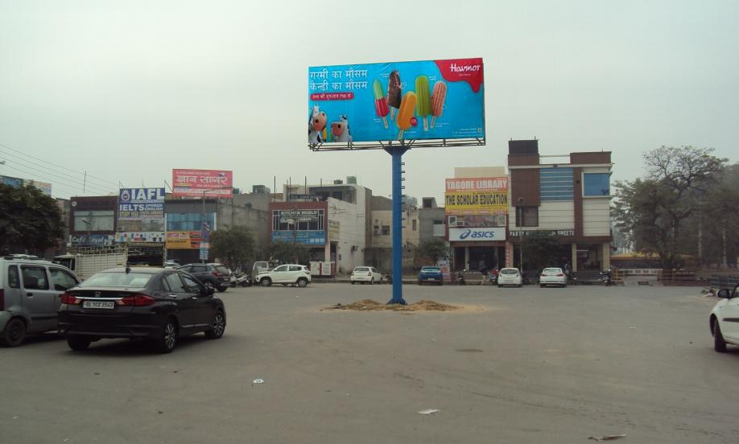
Hisar 20x10 ,Old court complex(Fc.Oxy.gym)

Slide 3
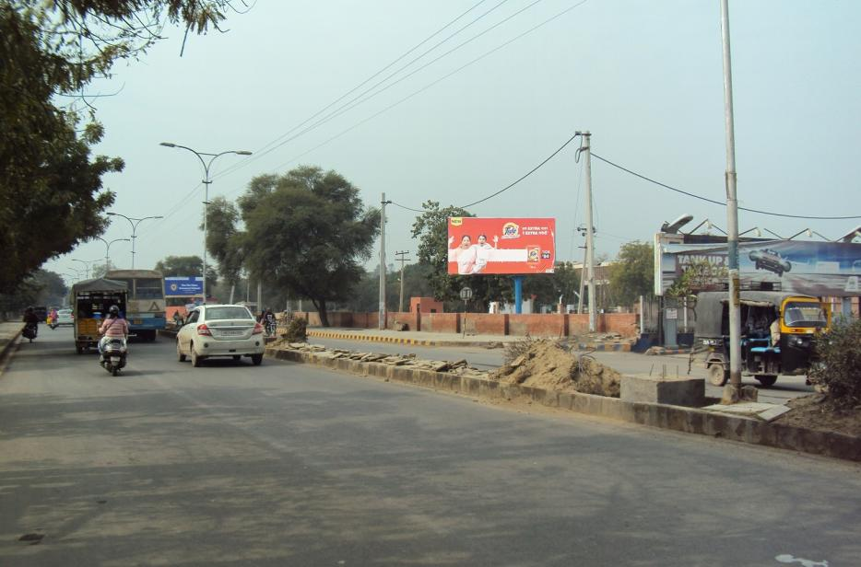
Hisar 20x10, Sec-15 mod Nr mini sectriat(Fc.Hisar)

Slide 4
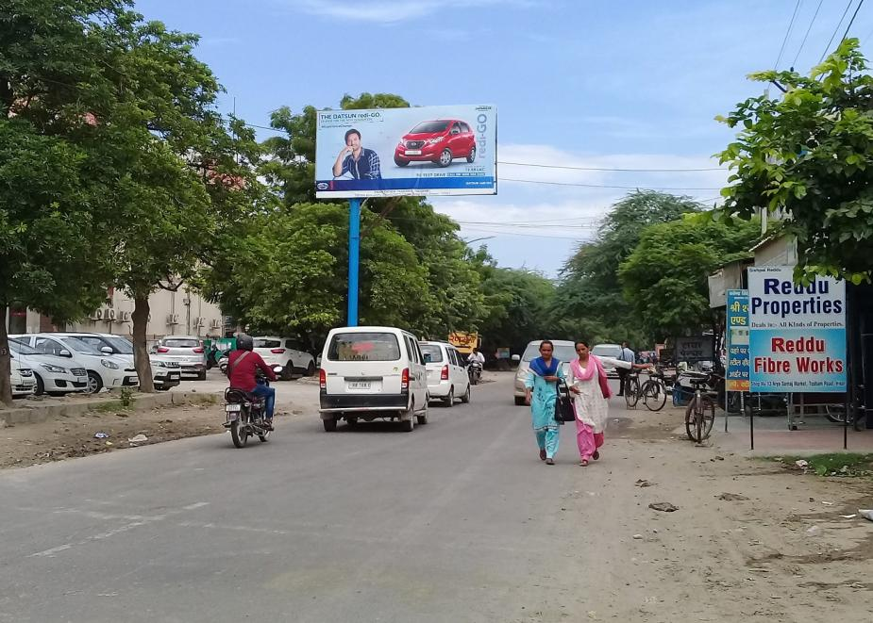
Hisar 20x10,Sec-13,(Fc.Sec-9-11)

Slide 5
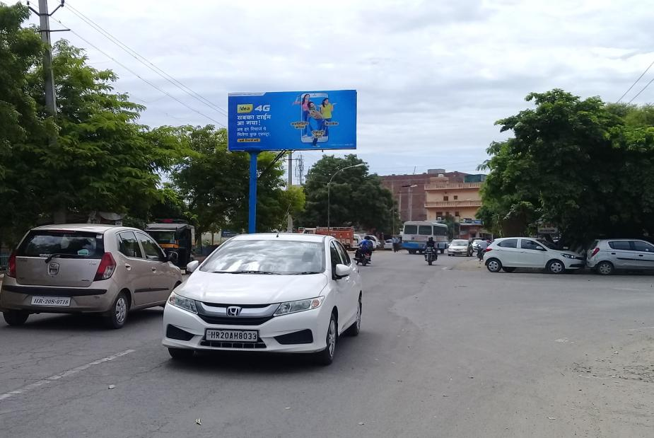
Hisar 20x10,Sec-13(Fc.Dabra chowk)

Slide 6
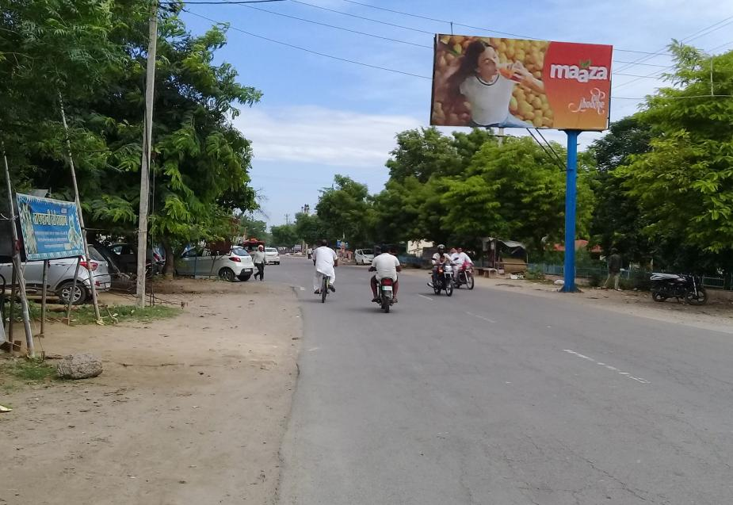
Hisar 20x10,Sec-13(Fc.ITI Chowk)(Available-04-02-2020)

Slide 7
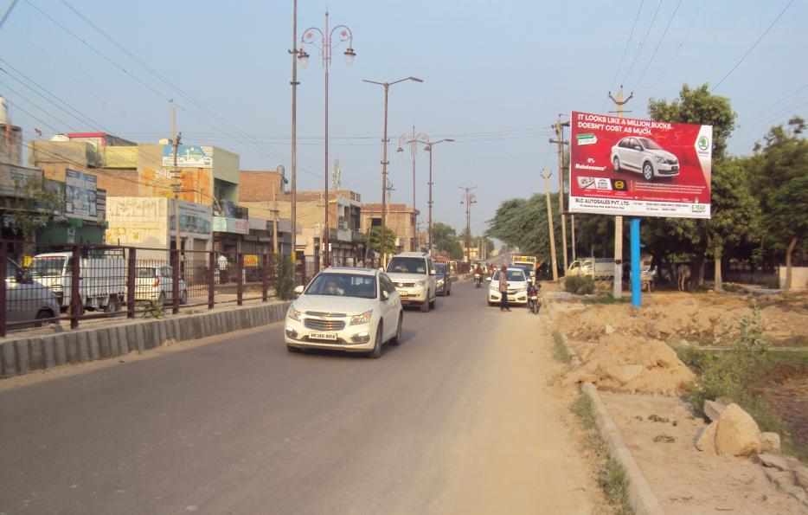
Hisar 20x10, Industrial Area (Fc. Hisar)

Slide 8
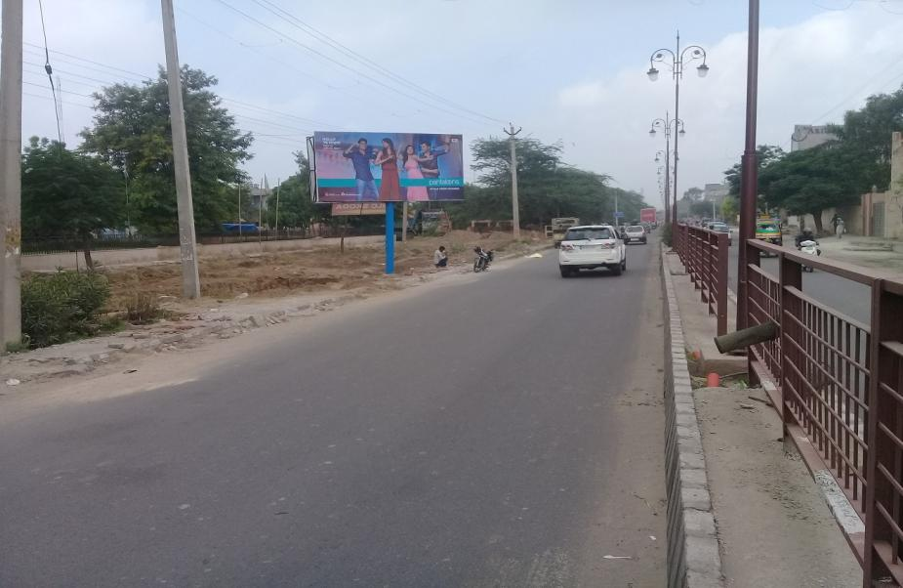
Hisar 20x10, Industrial Area (Fc. Dehli)

Slide 9
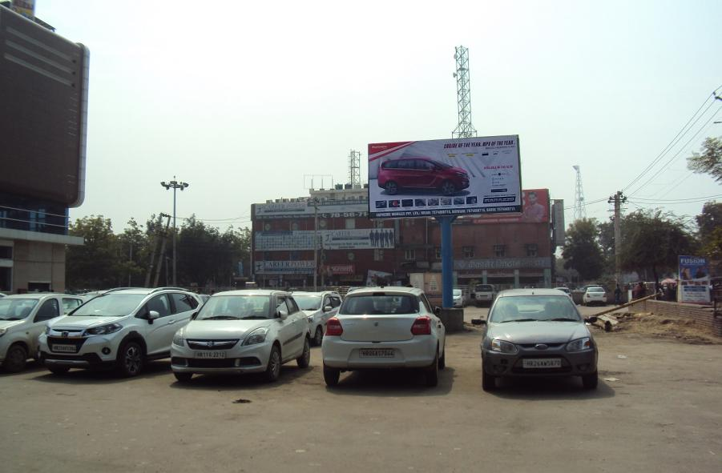
Hisar 20x10,Red Square Mrkt,Nr.Miraz cinema(Fc.Bus st.)

Slide 10
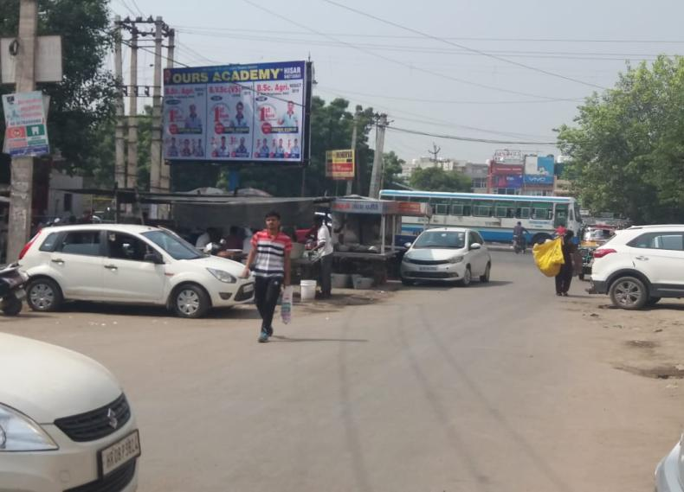
Hisar 20x10,Red squere mrkt(Nr miraj cinema)

Slide 11
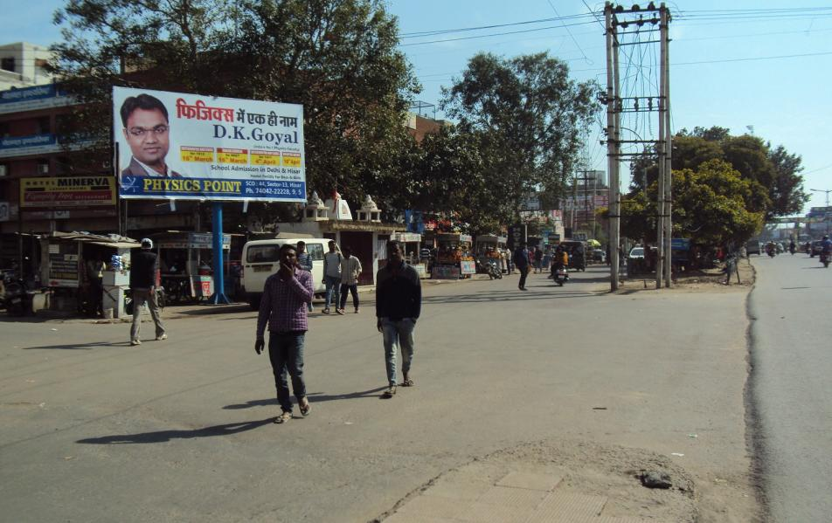
Hisar 20x10,Red Sq.Mkt.Nr.Telephone exchange(Single)

Slide 12
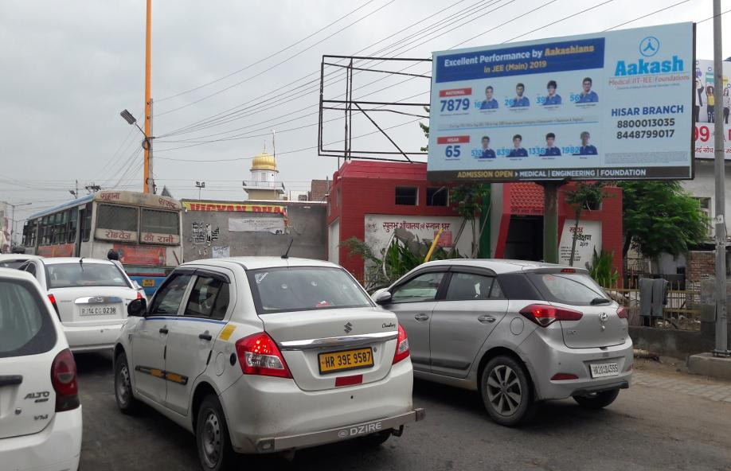
Hisar 20x10,Grover mrkt(Fc.Prijat chowk)(Available-04-01-20)

Slide 13
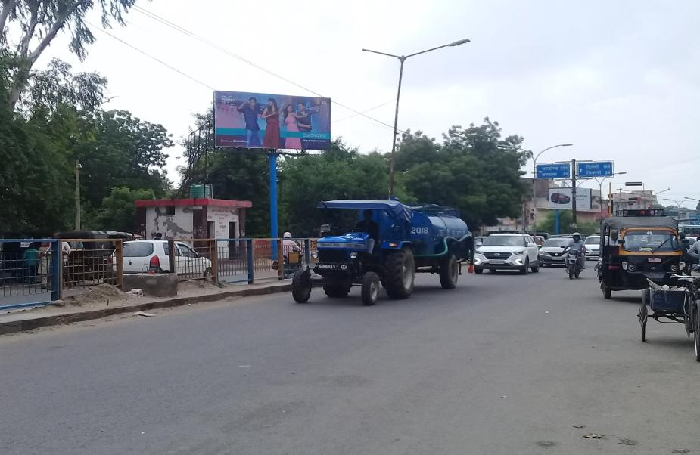
Hisar 20x10,Civil Hospital

Slide 14
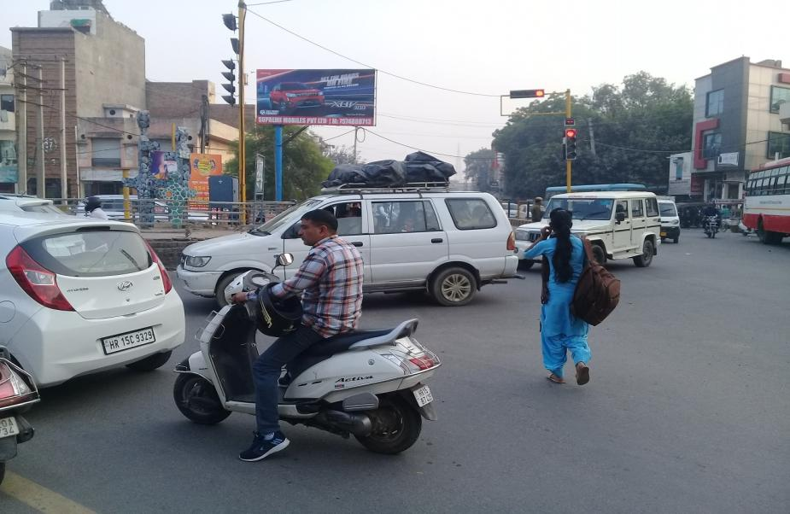
Hisar 20x10,Cloth mkt Opp. Bus st.(Fc.Civil Hospital)

Slide 15
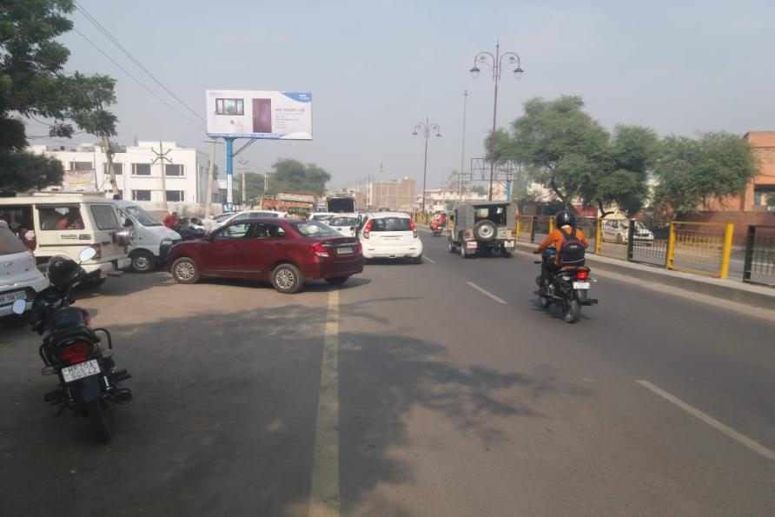
Hisar 20x10, Sirsa road Opp.Anaj mandi(Fc.Bus st.)

Slide 16
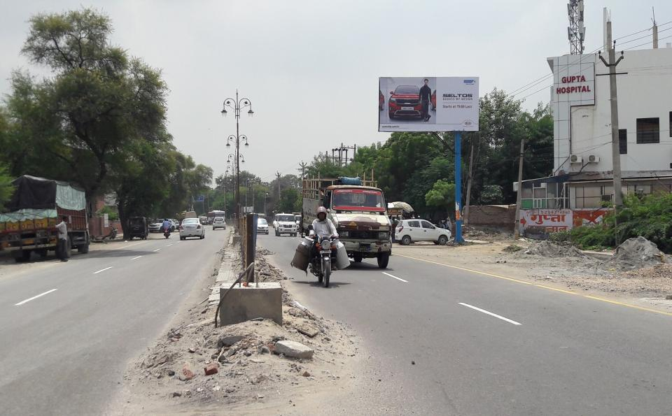
Hisar 20x10,Sirsa road,Sec-14 Opp.Anaj mandi

Slide 17
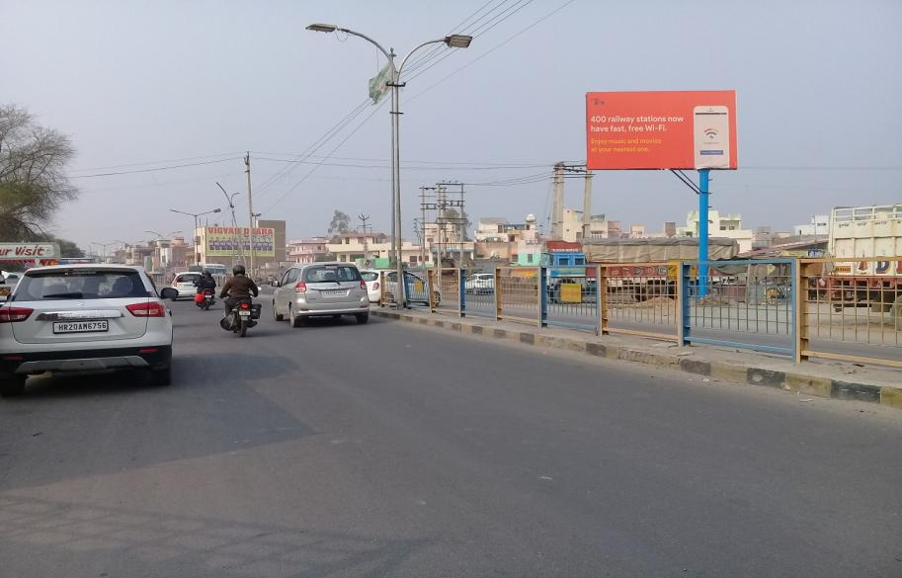
Hisar 20x10,Opp. Sec-14(Bus st.facing)(Available-04-02-2020)

Slide 18
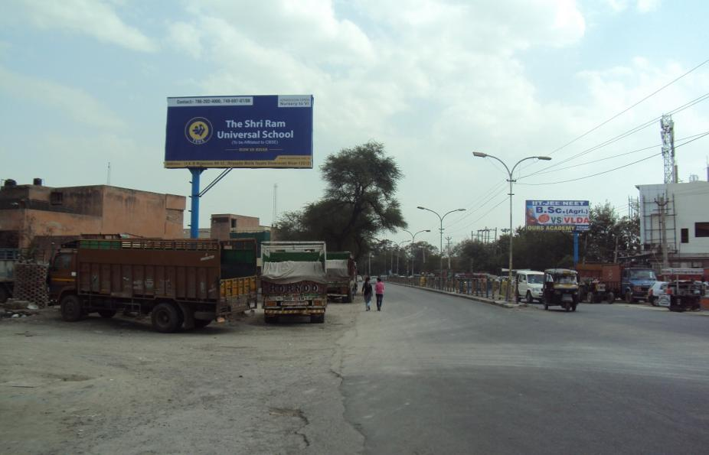
Hisar 20x10,Opp. Sec-14(Fc.Sirsa)

Slide 19
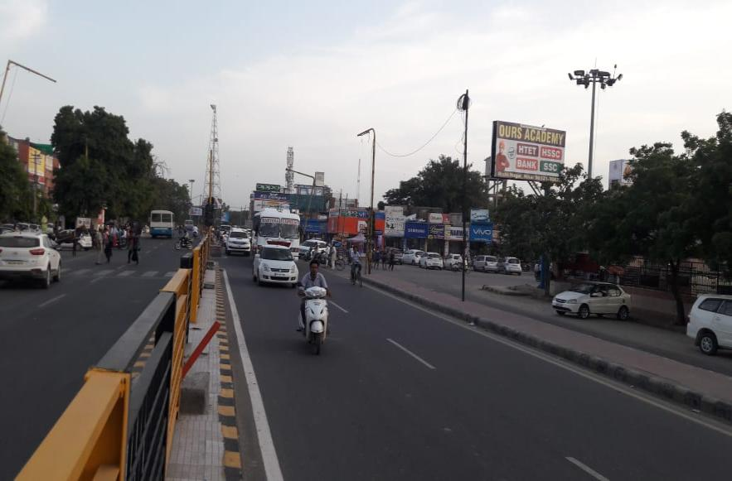
Hisar 20x10,Bikaner chowk(Fc. Bus st)

Slide 20
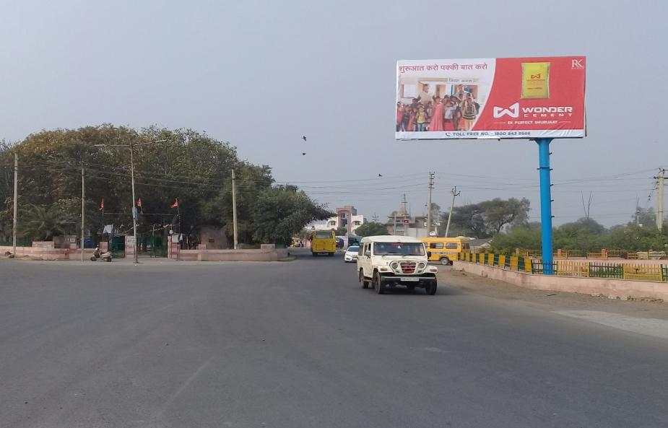
Hisar 20x10 Sirsa Chungi Hissar Entry ( Facing City)

Slide 21
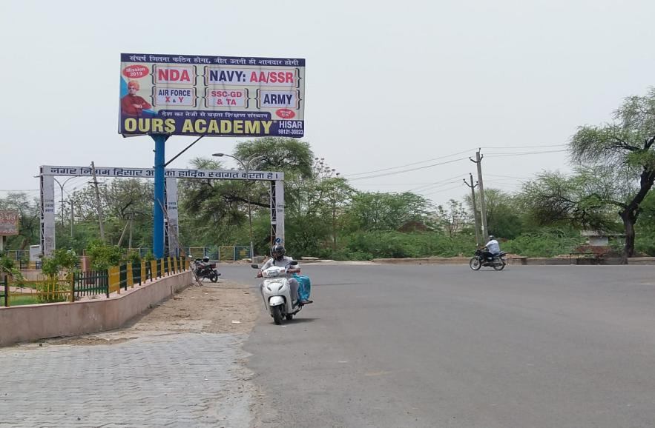
Hisar 20x10, Sirsa Chungi Hissar Exit ( Facing Sirsa)

Slide 22
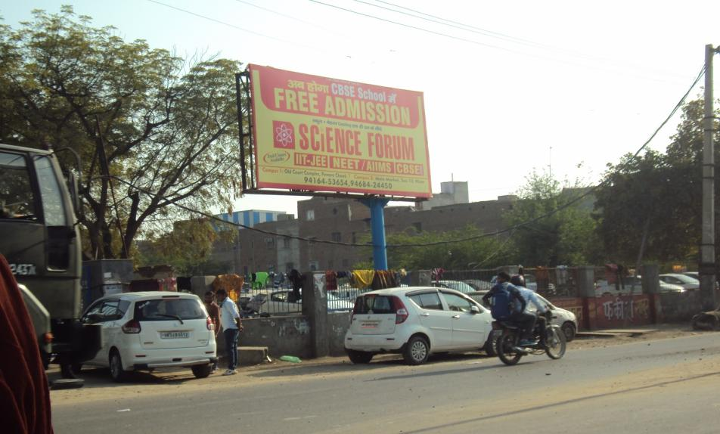
Hisar 20x10,Barwala Road

Slide 23
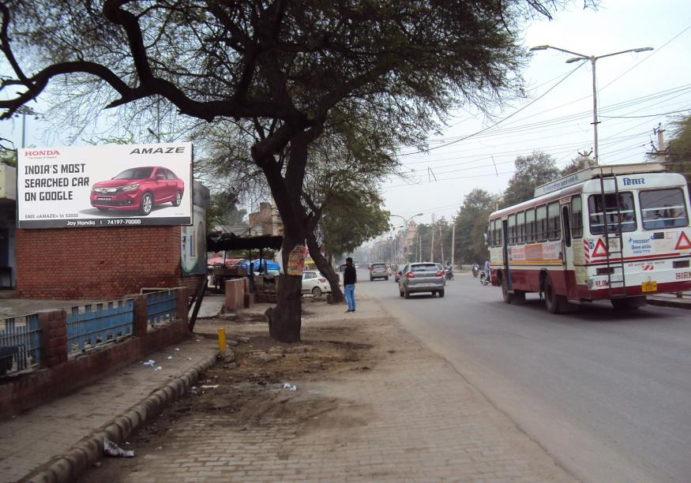
Hisar 18x8,Anaj mandi

Slide 24
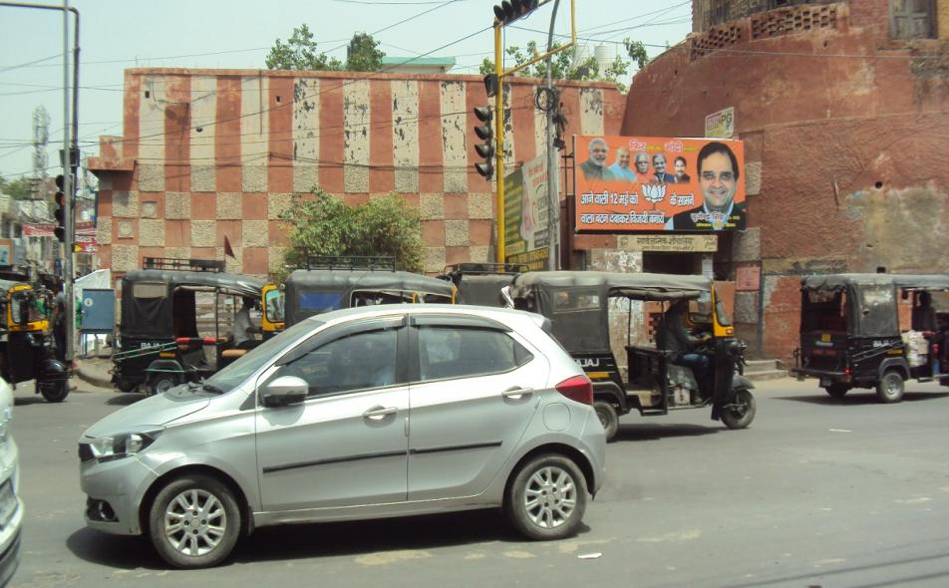
Hisar 13x6,Talaki Gate

Slide 25
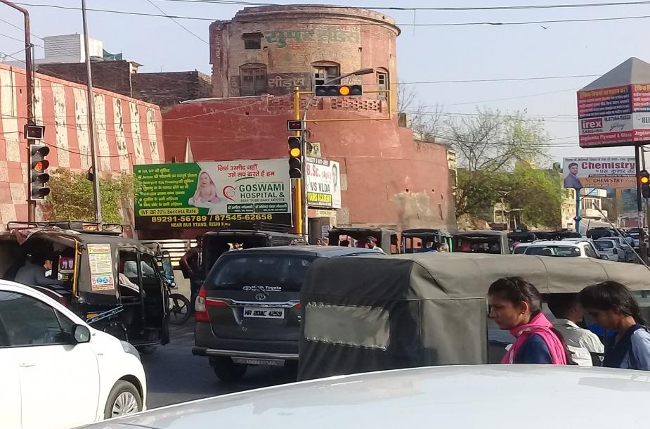
Hisar 18x8,Talaki Gate

Slide 26
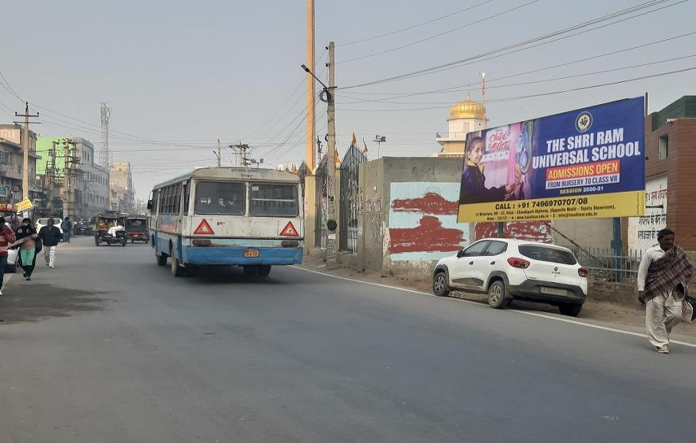
Hisar 18x8,Grover mrkt

Slide 27
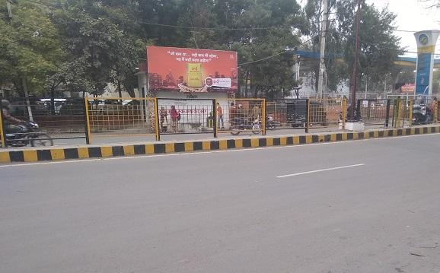
Hisar 18x8,IG Chowk

Slide 28
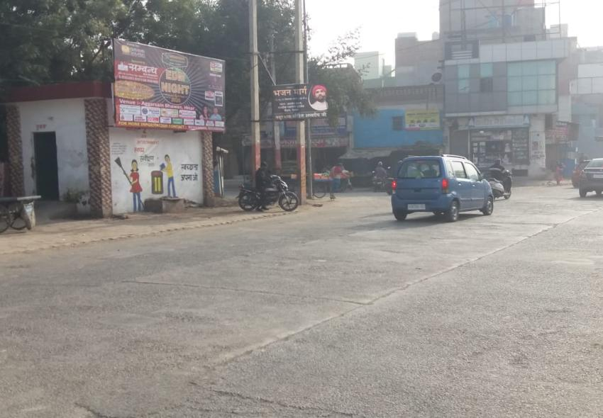
Hisar 18x8, P.L.A Sec-15 Turn

Slide 29
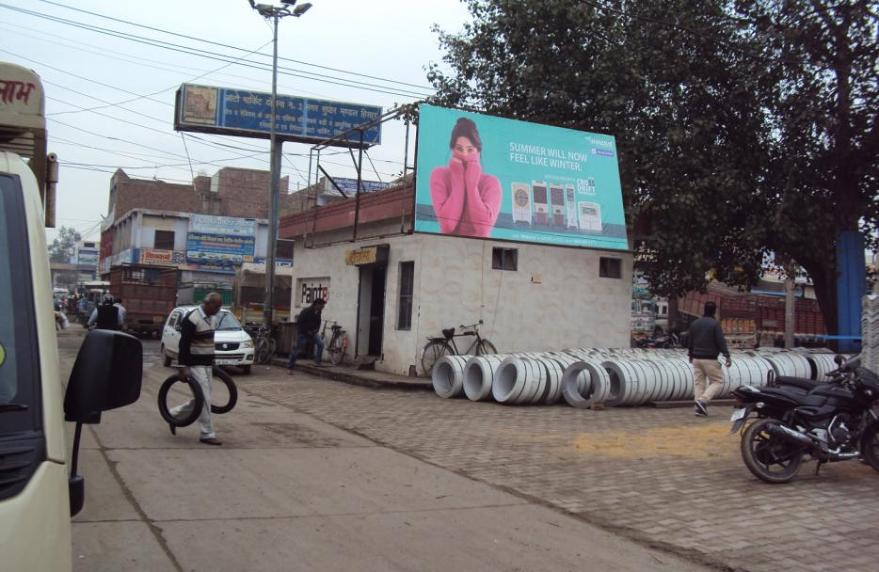
Hisar 18x8,Auto Mrkt

Slide 30
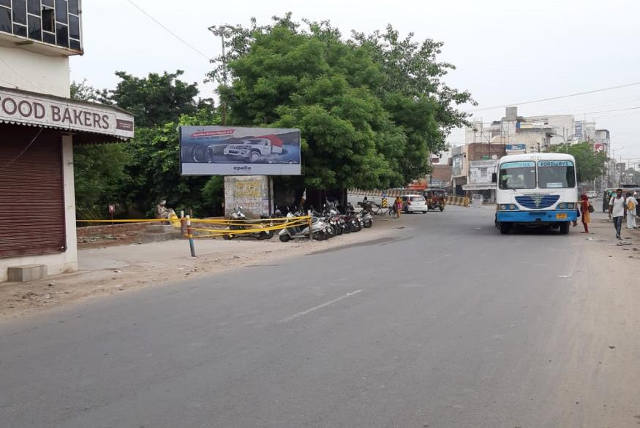
Hisar 18x8,Dabra chowk

Slide 31
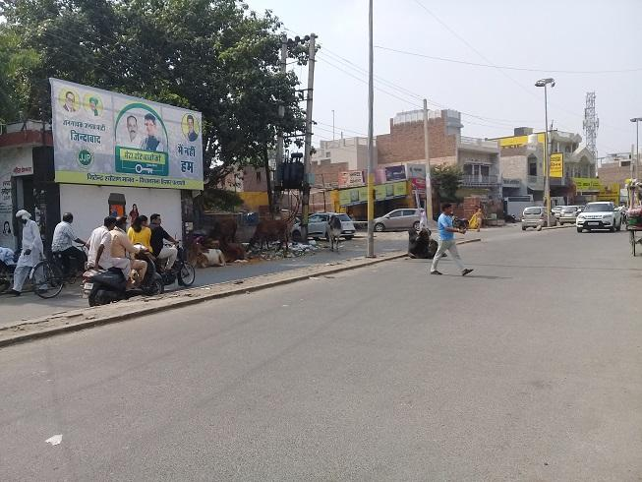
Hisar 18x8,Jelabi chowk

Slide 32
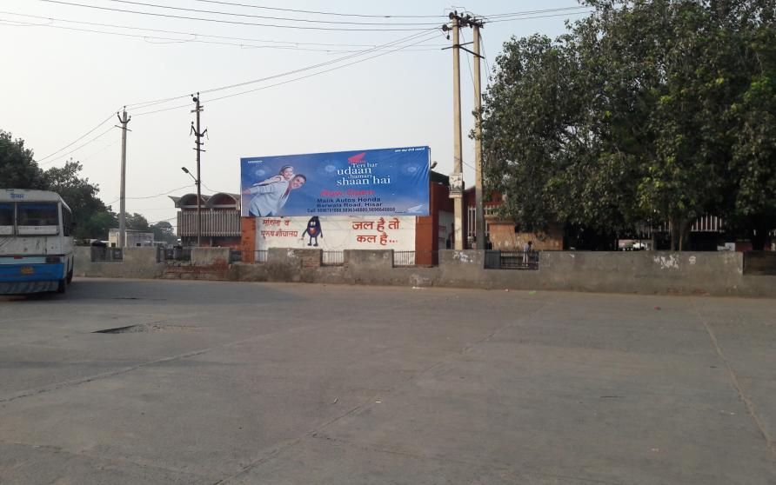
Hisar 30x8 Local bus stand

Slide 33
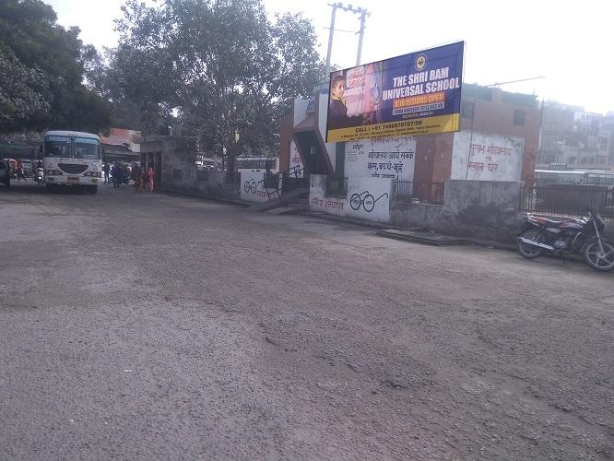
Hisar 18x8 Main bus stand

Slide 34
Terms & Conditions:
1. GST will be extra @ 18%.
2. Any damage to the flex due to heavy wind / storm activity or any rain Thunder-
shower activity, the cost of reprinting of the flex will be borne by client.
3. The sites are subject to the availability.
4. Printing & Mounting Extra as applicable.
5. 100% Payment advance in the favour of “ Redzo Media Solutions Pvt. Ltd “.

